Slide 1
Maltese Road Primary School
KS1
2024-2025

Slide 2
Start/Finish times
School gates open at 8:30am for pupils to arrive and enter their classrooms. All pupils should be in class by 8:40am as this is the official start of the school day.
Reception class finish at 3pm
Year 1 and Year 2 classes finish at 3:10pm
If children are not collected by 3:15pm, they will be sent to the library.
No MUGA play or climbing frame after school due to insurance.
Please note that staggered finish times are in place to help manage traffic congestion and parking in Maltese Road.

Slide 3
PE kit
KS1 PE days are:
Wednesday and Thursday.
black/green bottoms
white polo/t-shirt
black/white plain trainers
green/black jumpers
Earrings should be removed on PE days.
Year 1 will be changing into their PE kits in school.
If children do not have the correct PE kit they will not be able to take part in PE due to health and safety.

Slide 4
Homework/Reading
All children will receive:
Half termly writing bingo which will include activities linked to writing skills the children have been learning in school.
Spellings to practise on the back of the bingo sheet. These will be tested during dictated sentences on a Friday.
Maths will be set weekly on PurpleMash, you will not be able to access the work until after 4pm
Children are expected to read at least 3 times a week and this should be signed by an adult in their reading log. They will have the chance to be a super reader each time they read.

Slide 5
Books coming home
Sharing book and a group reading book.
The sharing book is closely matched to your child's phonetic ability but there may be certain sounds or tricky words which they have not yet learnt. The purpose of these books is for you and your child to have a go at reading and sharing them together, please tell your child a word if they are unsure of how to decode it or what it means. These books will be changed twice a week
The children will also bring a group reading book home which is matched to their individual phonics needs. They will have already practiced reading this book at school and should be mostly fluent by the time they bring this home. Please use this as an opportunity for your child to show off their reading and understanding of the text to you. These books will be changed once the children have finished their group sessions in school.

Slide 6
Phonics
This year we are following the Little Wandle scheme.
It will be a combination of using online resources and flash cards.
There will be a phonics check the week beginning 9th June. It is a national test and it is just to monitor how the early reading and phonics progression is coming along in EYFS and KS1
Please don’t worry, there is nothing to worry about, I will be doing the test with them and it is very informal.
If they don’t meet the threshold in year 1 they will redo it in year 2.

Slide 7
Positive Behaviour Policy
Please see the school website for our full Positive behaviour policy.
Make Great Choices!
Our recognition board and Magnificent Malteser are linked to our seven school values.
Creativity | Respect | Compassion | Co-operation | Responsibility | Courage | Resilience

Slide 8
Reward systems
Star of the Day!
Dojos will be awarded when adults notice children making the right choices. These will be turned into house points at the end of each week.
Magnificent Malteser to be awarded in line with the Maltese Road school values. These will be awarded every Friday in celebration assembly and certificate will be sent home.
Super reader to be awarded during celebration assembly. The more times they read, the more chance they get of being Super Reader of the week.

Slide 9
Uniform
The school uniform is; grey trousers or skirts/pinafores, plain white shirts, school grey jumper with school logo and school tie.
In the summer the girls may wear the green and white checked summer dress, girls socks should be white and may be knee length or ankle.
All items of clothing should be clearly named.

Slide 10
Snack
KS1 children will be provided with a choice of fruit for morning break.
If children would like to bring their own snack for the afternoon, please ensure this is a healthy snack (no chocolate, biscuits, crisps, nuts etc)
Some days in KS1 we will have an afternoon break (if time allows) and the children can bring in a snack for this. Sometimes we have enough fruit left over from the morning, but not always.

Slide 11
School equipment
Please ensure children have school book bags or small backpacks. Our pegs are not big enough to accommodate big rucksacks and coats.
Children should be bringing in their reading book and reading logs into school everyday for adults to check.
All children should have a named water bottle.
No pencil cases are needed at school.

Slide 12
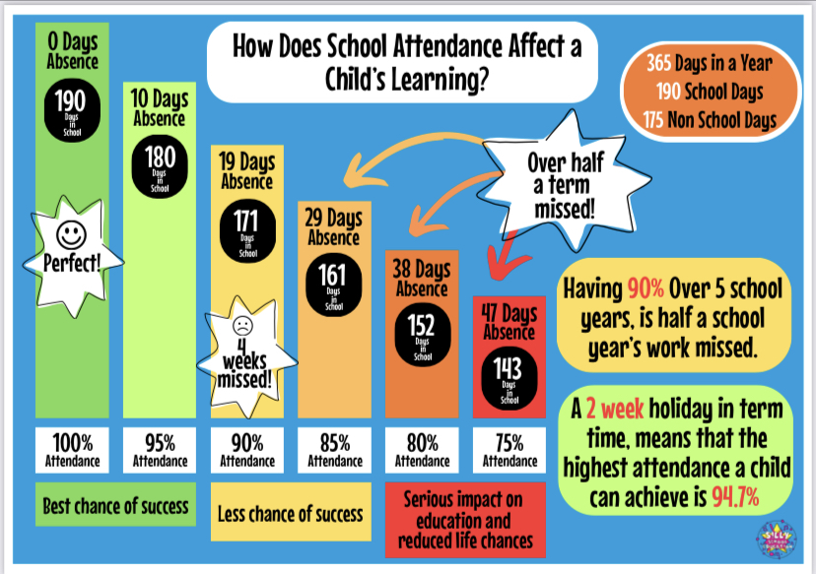
Attendance

Slide 13
Thank you for coming.
Please check the weekly newsletter and class Dojos for any other information.

