Slide 1
Mountain Lion
Mountain lions are known by many different names, including cougar, puma, red tiger and catamount.
They live in North and South America. They can survive well in mountainous habitats and can also be found in deserts and rainforests.

Slide 2
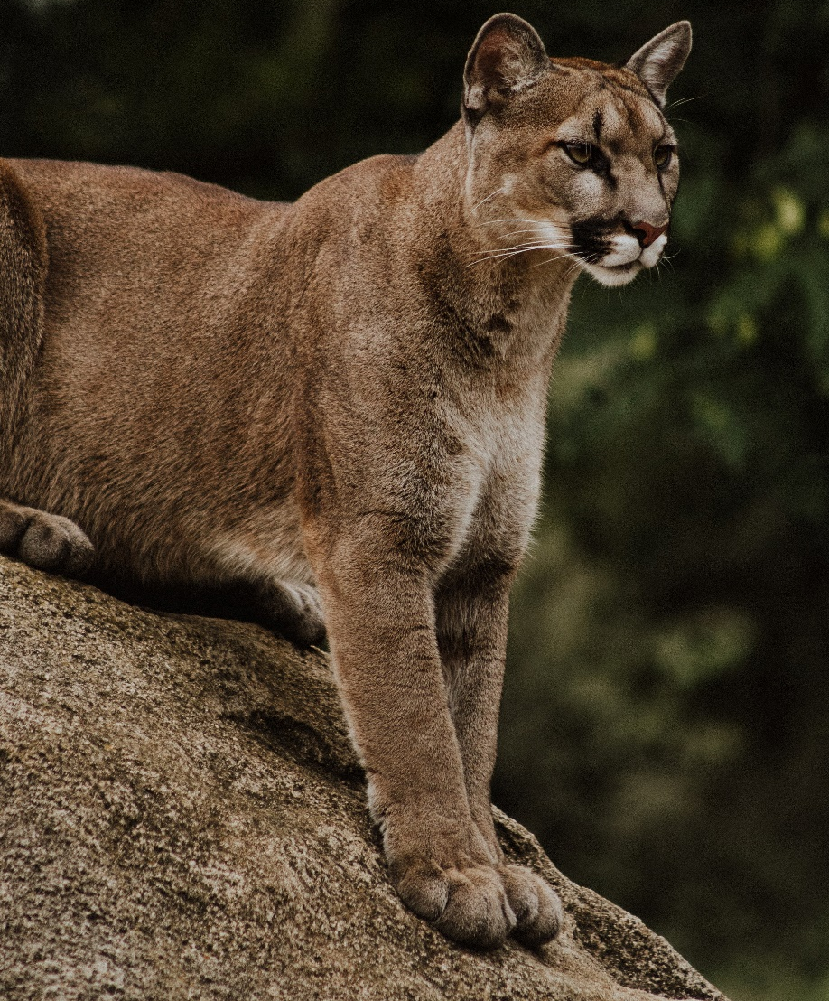

Mountain Lion
Mountain lions are carnivores
and mostly eat deer, as well as small mammals such as mice and rabbits.
Their sense of smell is poor but
their fantastic eyesight and
hearing help them to hunt their
prey at dawn and dusk.
carnivores – Animals that eat meat.
Did You Know…?
Mountain lions have very powerful legs, which allow them to jump distances of up to 13 metres (45 feet)!

Slide 3
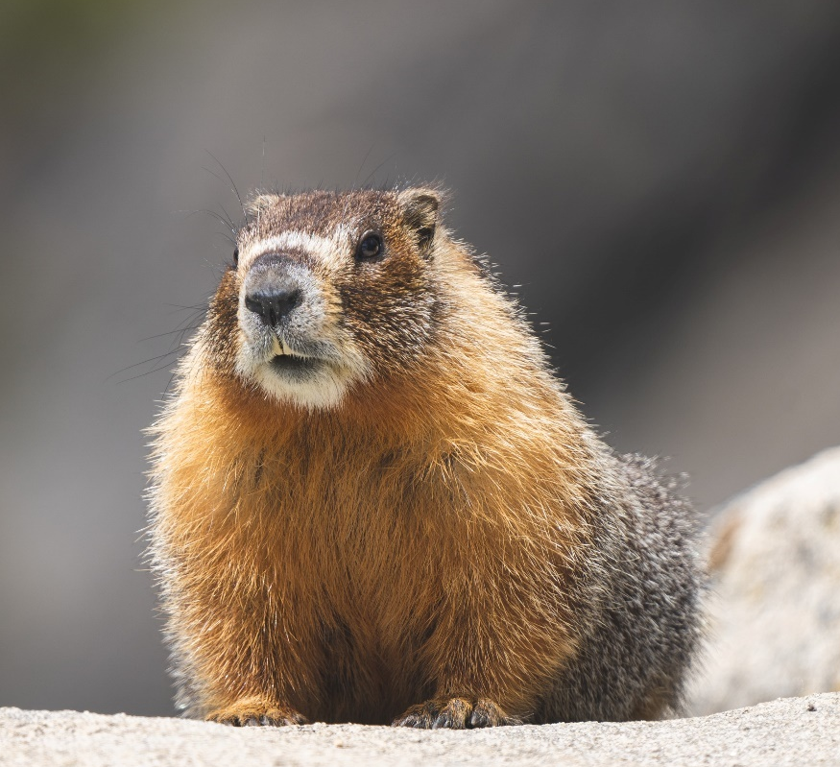
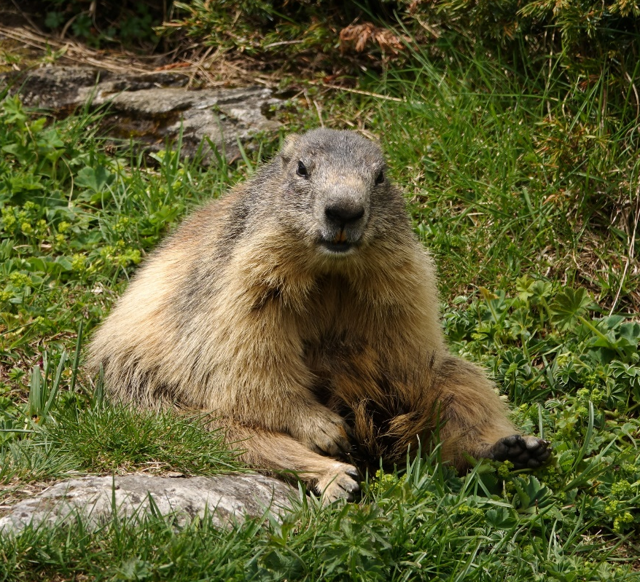
Alpine Marmot
Marmots normally live at altitudes between 2000 and 3000 metres (about 6500 – 10,000 feet) and are found in the Alps mountain range in Europe.

Slide 4
Alpine Marmot
They are fantastic at digging and have a special nail on their thumb that helps them to create burrows, which they spend most of their
time in.
In order to survive the cold
winter months, Alpine marmots
like to hibernate in their dens
from October until the beginning
of spring.

Slide 5
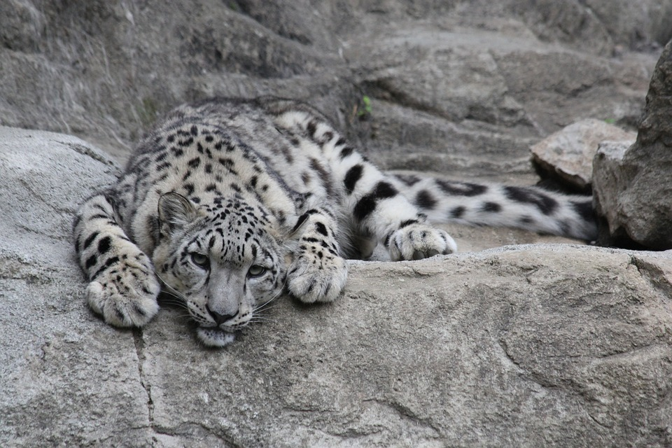
Snow Leopard
Snow leopards live in the rocky mountains of central Asia.
They are very difficult to see because their spotted coat acts as
a camouflage amongst the rocks. Because of this, they also have
the nickname ‘ghost cats’.
These animals are fierce hunters
and like to prey on bharal, ibex, mountain hares and birds.

Slide 6
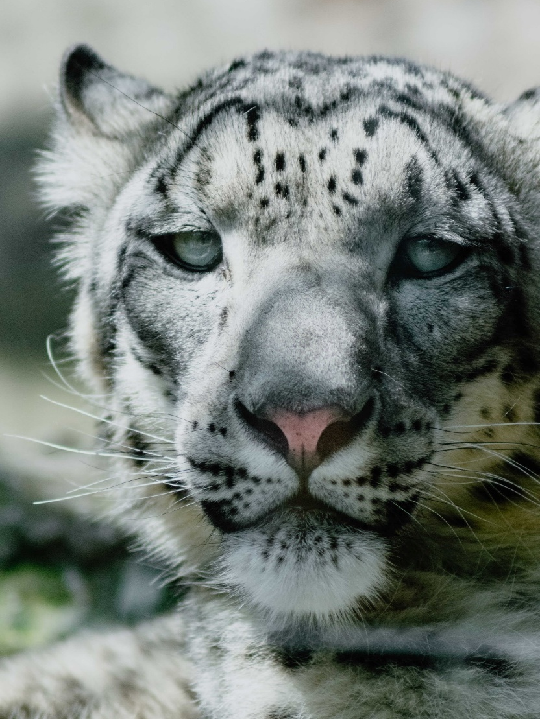
Snow Leopard
Snow leopards have very thick fur to help to keep them warm.
They also have large nostrils, which help to heat up the air they breathe before it enters their lungs.
Their large paws allow them to walk on the snow without sinking in and their long tail helps them to balance on unsteady ground.

Slide 7
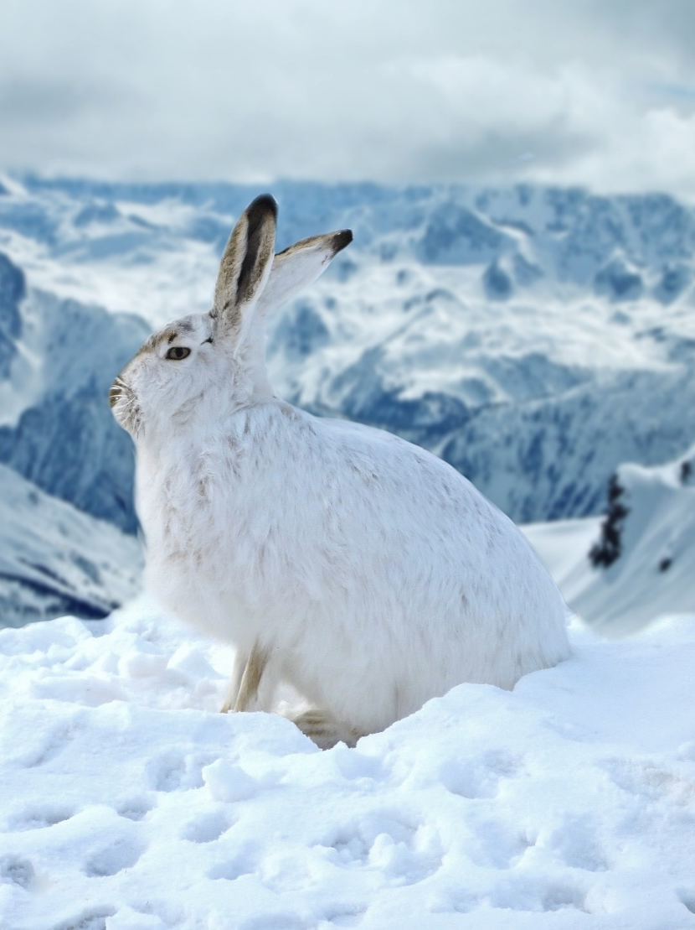
Mountain Hare
Mountain hares can be found in places such as Poland, China and the UK. They live in different habitats including forests, rocky hills and heathland.
They mostly eat leaves, twigs and grasses and they like to shelter in forms, which are dips in the
ground or grass.

Slide 8

Mountain Hare
Like the snow leopard, their large feet help them to spread their weight evenly on snow, which stops them from sinking in.
Did You Know…?
A mountain hare’s fur turns from brown to white during the winter months. Why do you think this is?
This provides them with excellent camouflage when it is snowy.

Slide 9
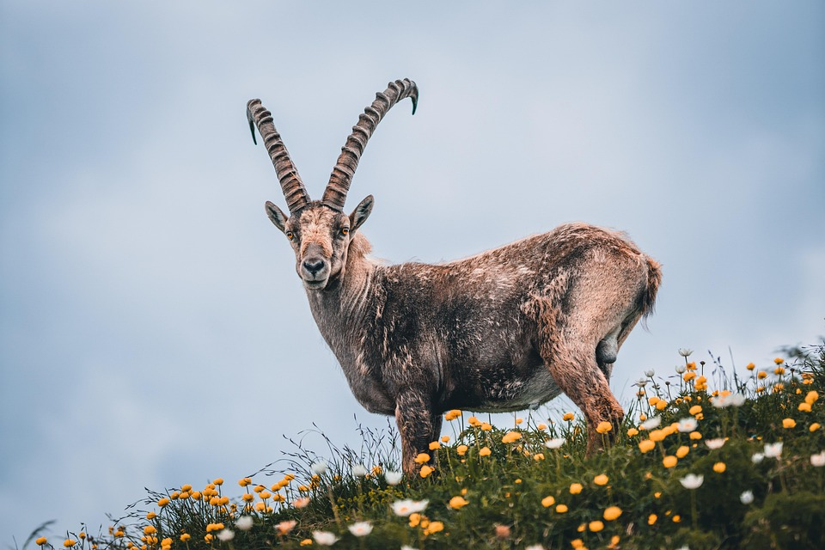
Alpine Ibex
The Alpine ibex is a type of wild goat that lives throughout the European Alps. They are often found between 500 and 3000 metres (about 1600 – 10,000
feet) above sea level.
They have large, curved horns, which they use to defend
themselves against predators.
predators – Animals that hunt other animals for food.

Slide 10
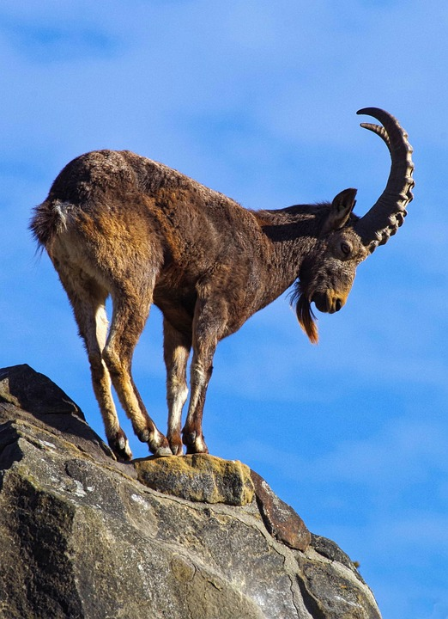
Alpine Ibex
Their fur changes with the seasons
to help them to survive.
In the summer, their coat is short, while in autumn, it becomes longer and darker. The dark colour helps them to keep warm because it absorbs more of the sun’s rays.

Slide 11
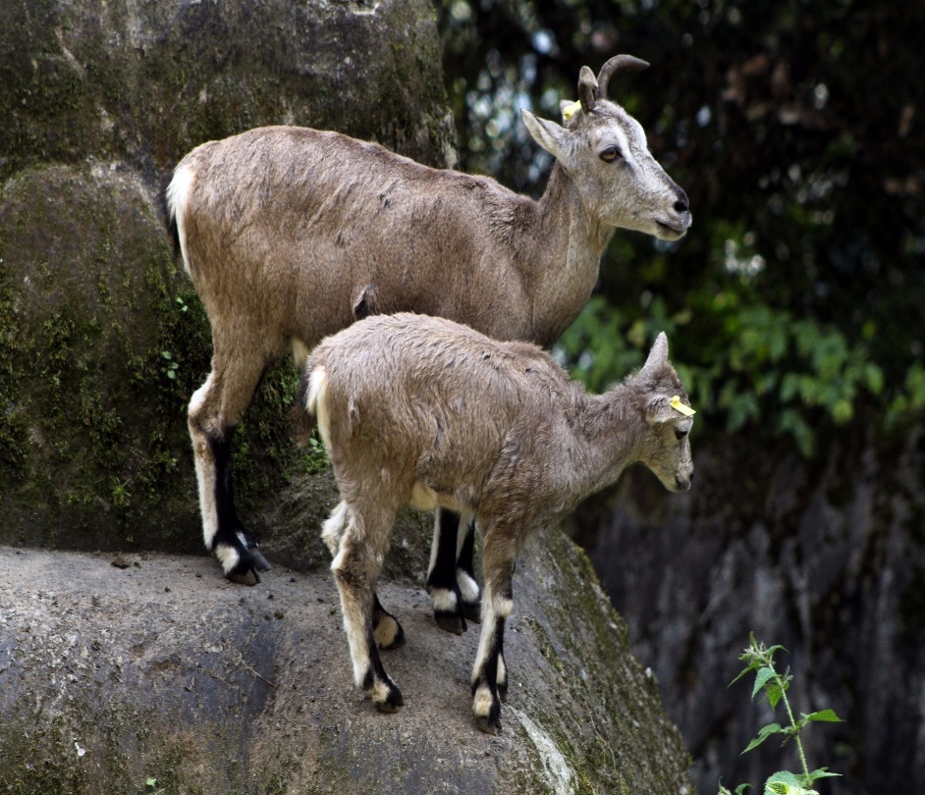
Bharal
Bharal, also known as ‘blue sheep’, are actually a close relative of the goat. They are found in the Himalayan mountains of many countries, including China, Bhutan and Nepal.
As their habitat has little shelter, bharal
stand completely still when they spot a predator. This helps them to blend into the rocky landscape and makes them trickier
to see.
If they are noticed by a predator, they can run quickly into the steep hills, where few animals are able to follow them.
‘Himalayan blue sheep (Pseudois nayaur), Himalayan Zoological Park, Darjeeling’ by [flowcomm] licensed under CC BY 2.0.

Slide 12
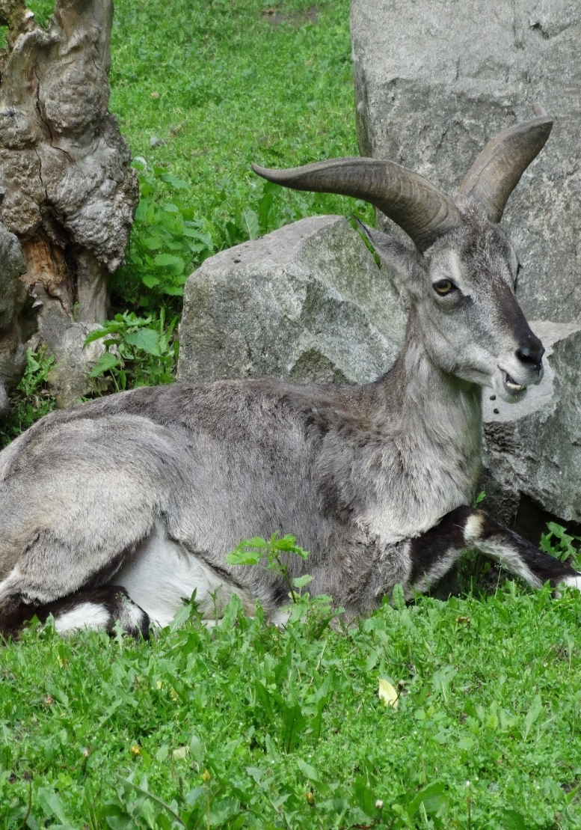
Bharal
Talk About It:
Bharal are hardly ever found in forests. Why do you think this is?
They are very easy to spot in forests because of the colour of their fur. This would make them an easy target for predators.

Slide 13
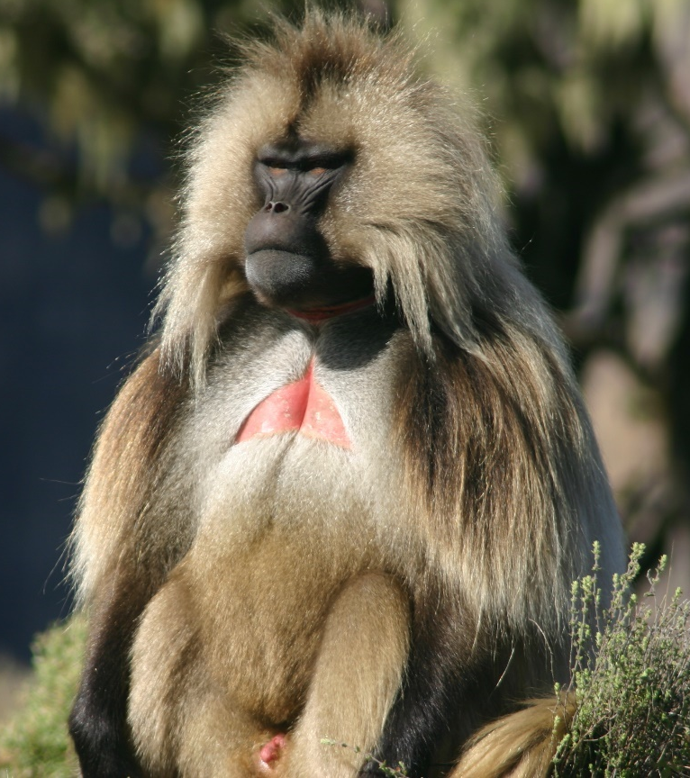
Gelada Monkey
Gelada monkeys can only be found in the high mountain meadows of Ethiopia in Africa.
They look similar to baboons and have
a large, red marking on their chest.
Gelada monkeys have small, thick fingers, which are excellent for climbing rocks and plucking grass to eat.
They are mainly grass-eaters but have very sharp teeth to help defend themselves.

Slide 14
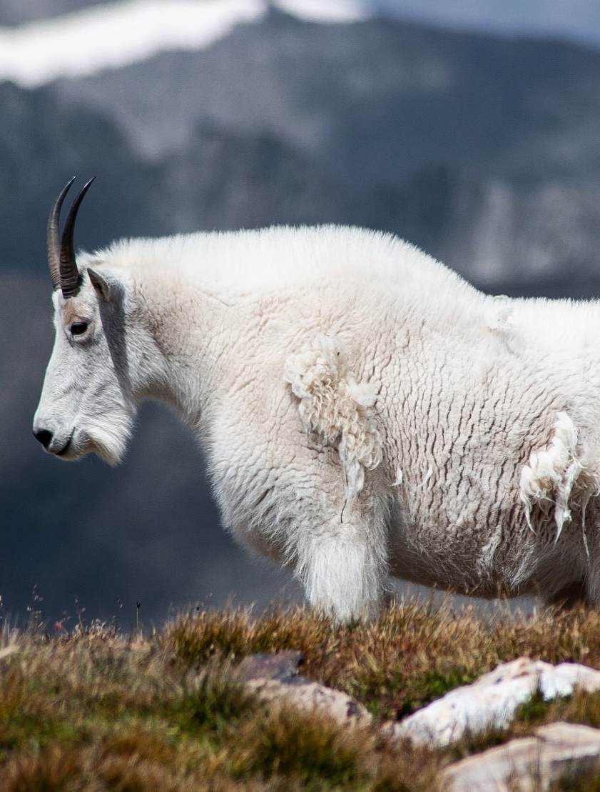
Mountain Goat
Mountain goats mostly live in the mountains of North America.
They have thick, woolly coats
that help them to keep warm.
Their white wool allows them to blend into the snowy mountains and hide from predators such as mountain lions and brown bears.

Slide 15
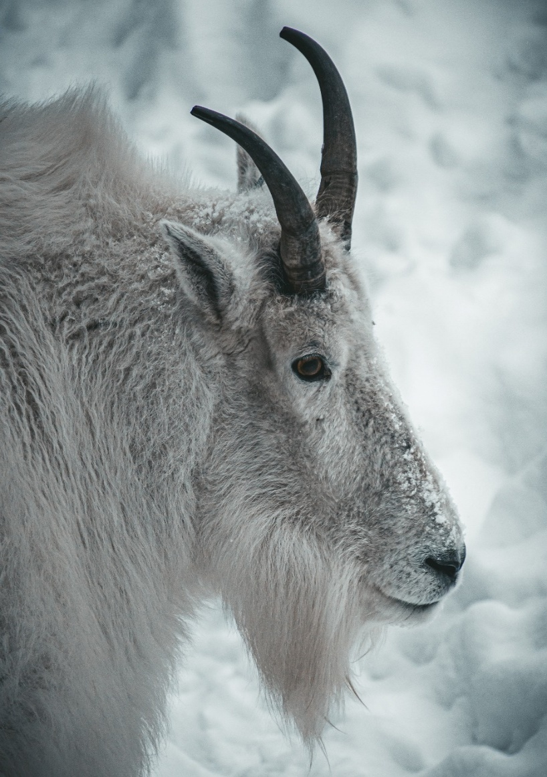
Mountain Goat
They are incredible climbers and have rough toe pads on their
hooves, which help them to grip tightly to the ground when
running up and down the steep mountain slopes.

Slide 16
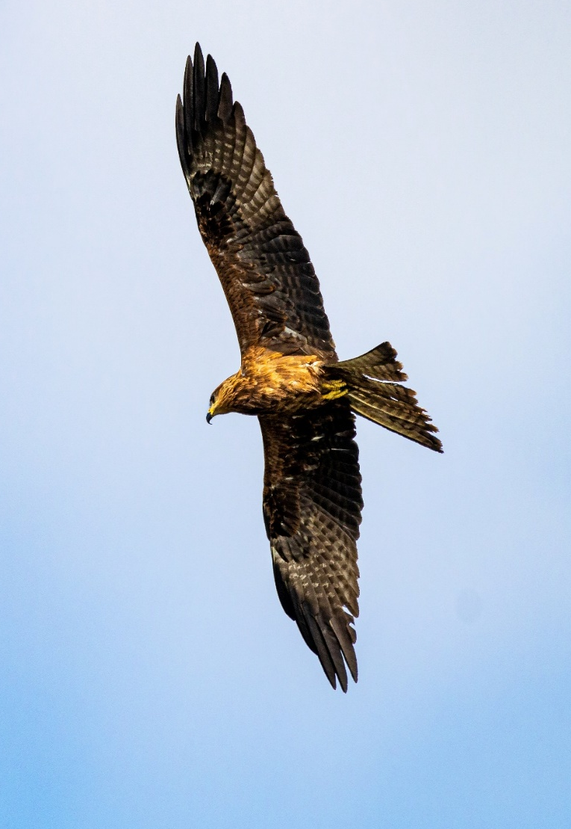
Golden Eagle
Golden eagles are found in the mountain regions of North America, Asia, Europe and
northern Africa.
They love open, mountainous habitats because they make
spotting prey easier. They are also able to fly in very powerful winds.

Slide 17
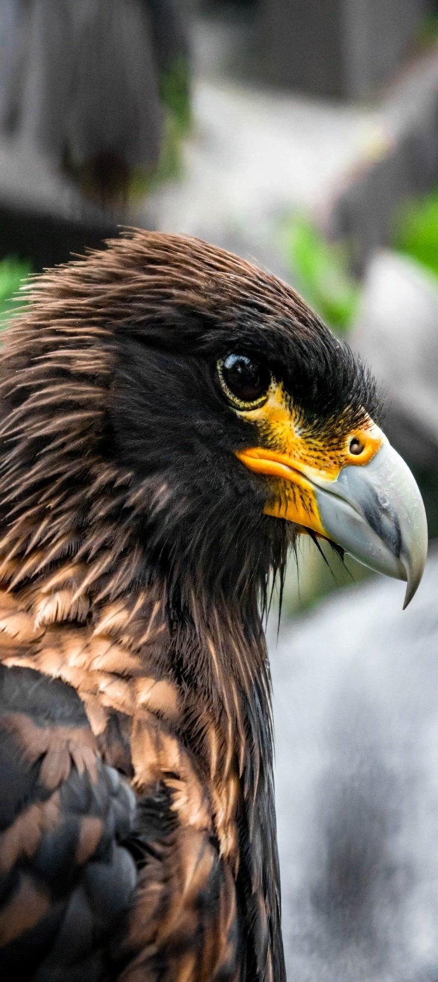
Golden Eagle
Golden eagles have wonderful eyesight and sharp talons, which help them when hunting.
They mostly eat small mammals, like rabbits and mice, but are also known to hunt larger animals,
such as badgers.

