Slide 1

Year 6 Residential Trip
Essex Outdoors, Mersea
11th-13th June 2025

Slide 2
Our aims….
To support and enrich the National Curriculum.
To encourage social skills.
To encourage independence, resourcefulness and problem solving skills.
To have fun!

Slide 3
Contact Information
https://www.essexoutdoors.com/our-centres/mersea/
Address:
Essex Outdoors Mersea,
Rewsalls Lane,
Colchester
CO5 8SX
Tel: 01206 383226
Out of hours emergency contact
If you need to contact your child out of school hours as a result of an emergency whilst the trip is underway, please email f.white@maltese.essex.sch.uk

Slide 4
Who’s going?
Mrs White, Mrs Millwood, Mrs Lefevre and Mrs Farrell
All adults have experience of taking children away on residential visits and therefore will ensure that your children have the best fun possible! ☺

Slide 5
Activities
The children will be put into 3 groups and will take part in a wide range of activities.
All activities are carried out by qualified leaders with staff members on hand at all times to support.
Children do not have to take part in the activities, however we try to encourage them to take as many chances as they can!
All activities encourage team work ☺

Slide 6
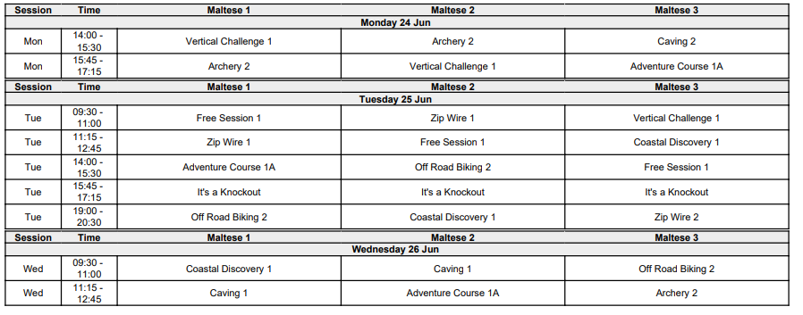
Activity Schedule (example)

Slide 7
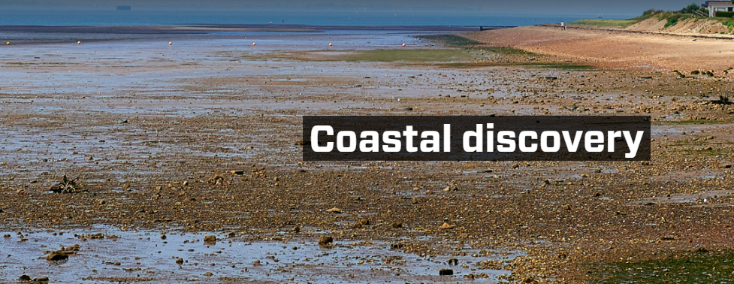
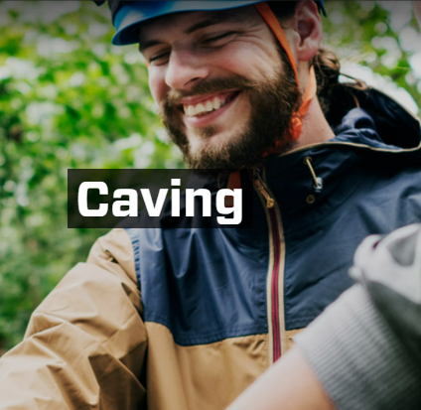
Blending the best of environmental education and forest school principals with fun activities. Find about the fascinating seashore life of the Blackwater estuary.
Work your way through the winding tunnels, chambers and features of our 4 artificial caving courses, avoiding the dead ends to find the exit. Suitable for those with or without a fear of enclosed spaces. Your group will be encouraged to work together to find the quickest way through the maze completing a series of challenges as you go.

Slide 8


Archery
Aim for gold on our outdoor and indoor archery ranges. With its unique mix of fun and competition, archery is a popular activity with all ages and abilities, helping to build confidence and improve coordination skills.
Navigate rope swings, tyre squeezes, tunnels, rope bridges, vertical walls, cargo nets, and the legendary ‘pit’ at our Mersea centre – prepare to get mucky!

Slide 9

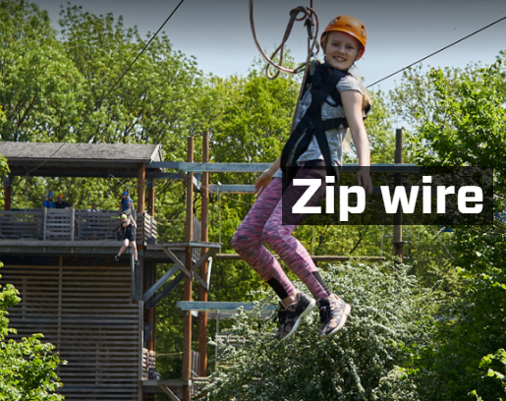
Try and conquer the water tower, or reach the end of the bungee run. Test your combat skills on the gladiators or see who can collect the most balls from the ball pit!
A fun personal challenge. Participants are connected to a wire 12 metres above the ground, before stepping out into thin air and embarking on a 100m descent. The experience will have you pleading for a second go!

Slide 10
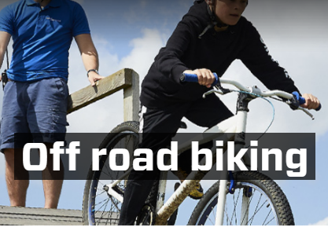
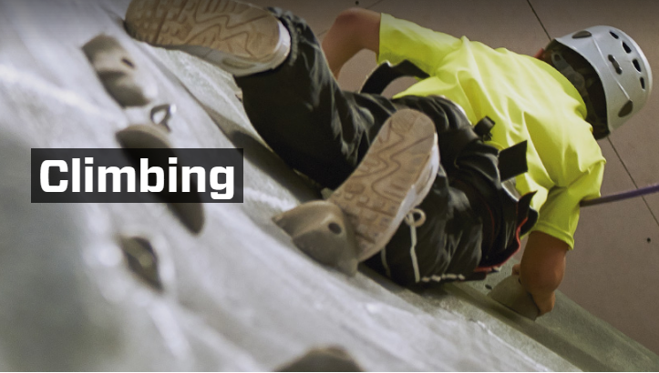
Enjoy the ride.
Our centres are perfectly situated to cater for all levels of off-road biking. Each site presents plenty of challenges, from obstacle courses to build your skills through to gentle woodland trails and more technical routes.
Reach new heights on one of our impressive outdoor towers or indoors at our fourteen metre high professional climbing wall – “The Lock”.
Our climbing walls provide a huge variety of routes to challenge novices and advanced climbers alike.

Slide 11

Travel Arrangements
On Wednesday 11th June arrive at school as normal; the coach will be leaving school around 10am.
There will be a designated bag drop off point –TBC.
Any medication should be clearly labelled (name, dosage, frequency) and handed to one of the leaders.
If your child requires travel sickness medication, please ensure this is given in the morning or provided for a member of staff to give before travel.
On Friday 13th June we will leave Mersea at around 2.00pm after our lunch and hope to be back by 3.00pm.

Slide 12

Pocket Money
There is a small shop on the Mersea Outdoors site where children can purchase gifts and sweets.
We have set a limit of up to £15 for each child to take (£5 per day). This should be packed in their suitcase in a wallet/purse/money bags. It will be your child’s responsibility to look after their own money for the duration of the trip.
P.S. Teachers have been known to confiscate large amounts of biscuits and sweets!

Slide 13
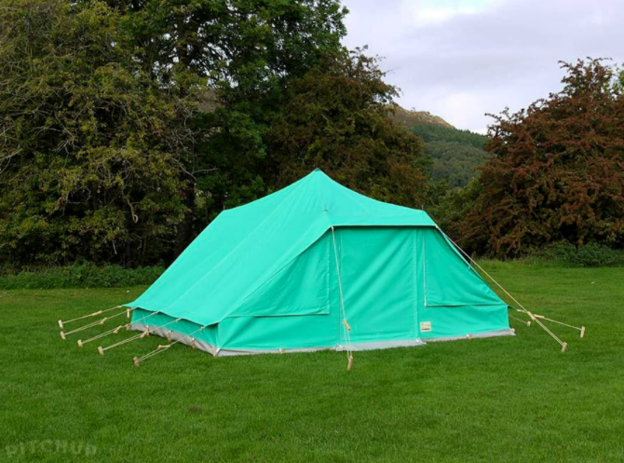
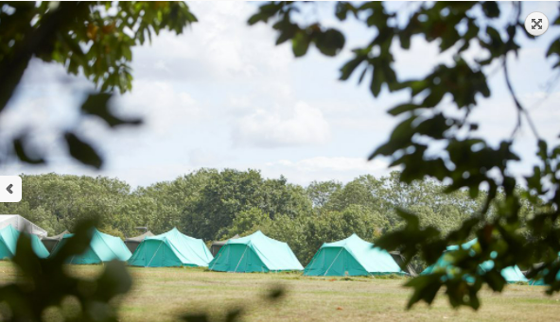
‘Sleeping’ arrangements
The children will be sharing tents with children of the same gender.
We will ask the children to list 3 children who they would like to share a room with.
Groups will be allocated according to children’s requests as much as possible.
We will inform the children who they will be sharing a tent with before we travel.
The minimum number of children in a room is 6 and the maximum is 8.

Slide 14
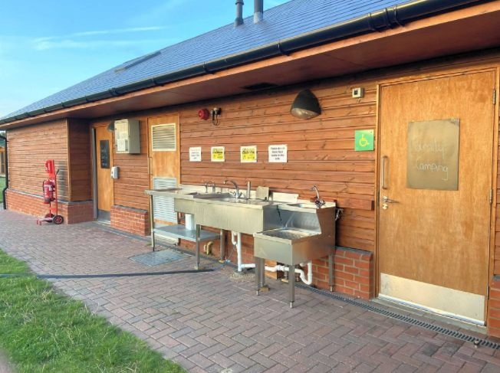
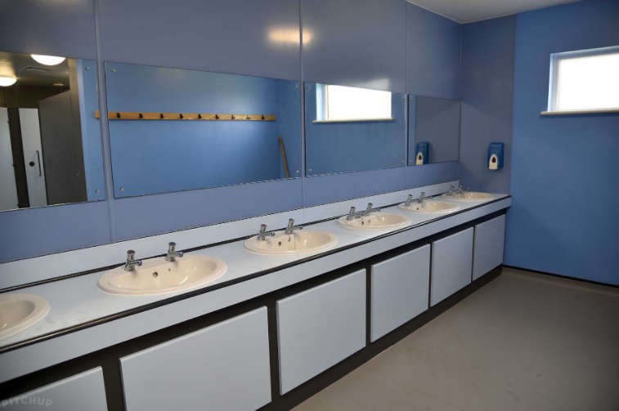
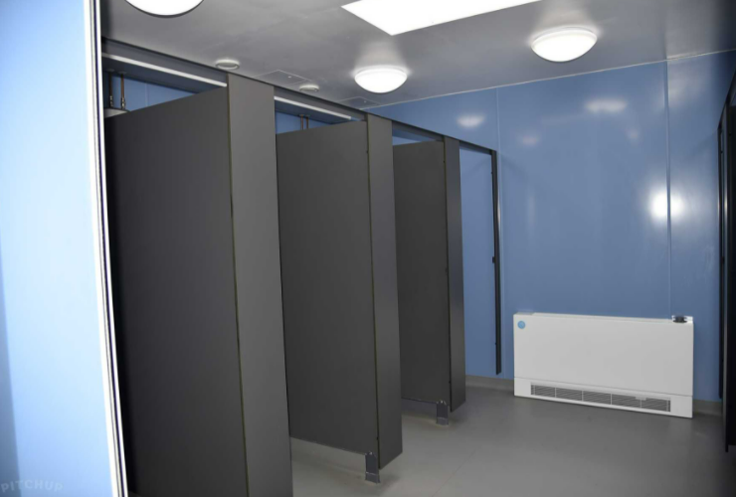
Facilities

Slide 15

Eating Arrangements
On Wednesday 11th June, the children will need to bring a packed lunch in their day bag which they will eat at Mersea. Dinner will be provided.
On Thursday the children will receive breakfast, lunch and dinner.
On Friday, the children will receive breakfast and lunch before they leave.
The menu is designed to support the 5-a-day campaign and minimize added salt, sugar and fat where possible. Mersea are a nut free environment and request parent/guardians do not to send their children with any products that contain nuts.
Please ensure you have notified us of any dietary requirements/allergies on the medical form as we will need to inform the staff at Mersea as soon as possible.

Slide 16
What to bring (3 days,2 nights):
Bedding:
Sleeping bag/single duvet
Pillow
Clothing:
Underwear
Socks – pack extras as they may get wet
Old clothes for activities: e.g. comfy trousers/jogging bottoms,
t-shirts, shorts, jumpers etc
Clean, comfy clothing for the evenings
Waterproof jacket
Shoes:
Old pair of trainers for activities – likely to get wet/muddy
A pair of clean, comfy shoes to wear in the evenings
Flip flops or crocs for shower visits
Extras:
One towel for showering
One old towel for wet/muddy activities
Wash bag (shower gel, shampoo, toothbrush, toothpaste, deodorant etc)
Tissues and hand sanitiser
Sun cream and a cap
Labelled bin bag for wet clothes/dirty washing
Rucksack/bag to carry essentials throughout the day
Camera (disposable is best – children will be in charge of any personal items)
Books, playing cards, pen and paper etc.
Torch (and spare batteries)
A named water bottle
Spending money £15 maximum (£5 per day) in a named purse/wallet.

Slide 17
Medical and dietary forms
Please ensure that all medical forms are returned to school as soon as possible.

Slide 18
Questions?

