Slide 1
Autism Central Peer Education Programme
Support and Information for Parents, Carers and Personal Assistants of Autistic Children and Young People

Slide 2


A Three Part Offer
A free service for parents/carers of autistic people, with or without a diagnosis.
Peer Educators are all parents/carers with lived experience of autism. They are trained in sharing their knowledge and experience and offering support.
East of England Hub
Essex, Southend and Thurrock, Suffolk and Waveney, Norfolk, Cambridgeshire, Peterborough, Hertfordshire, Bedfordshire, Milton Keynes and Luton

Slide 3


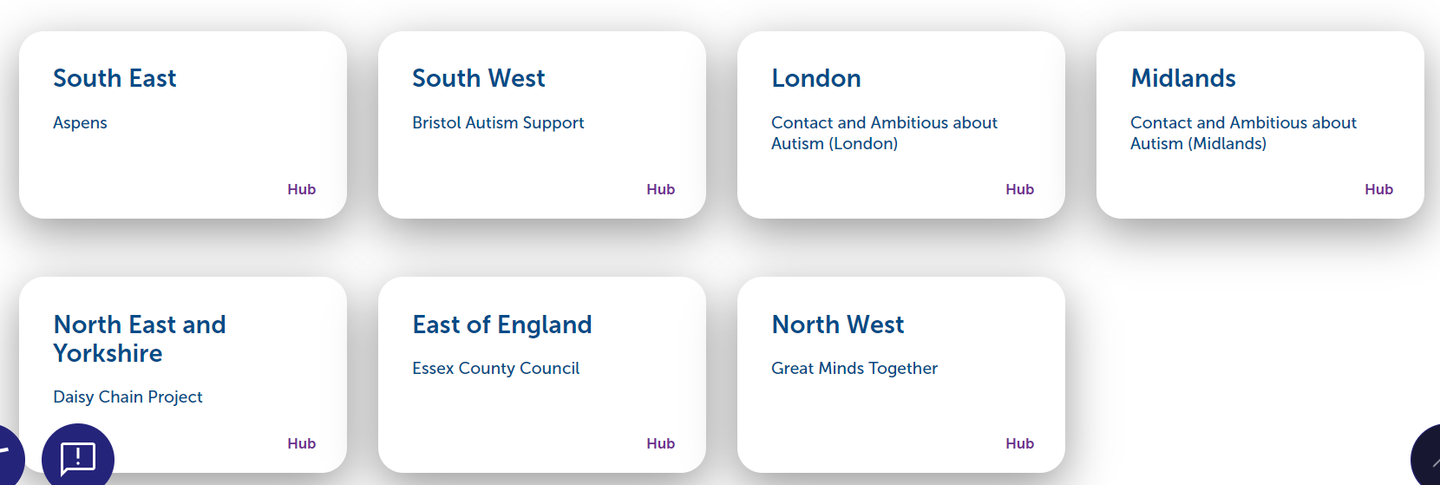
Who is involved in Autism Central?

Slide 4

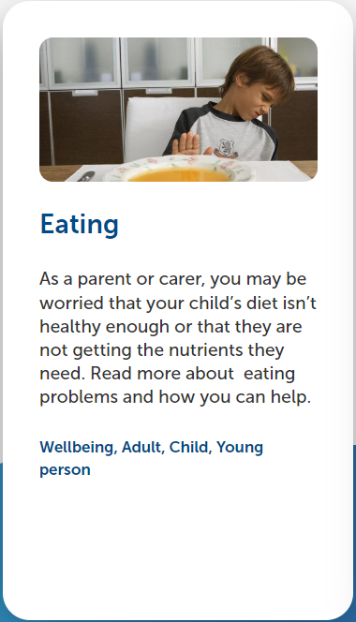
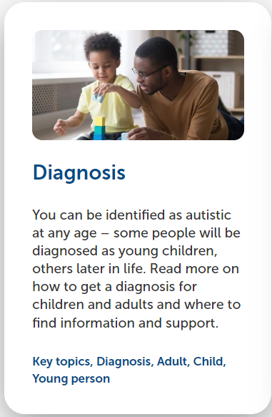
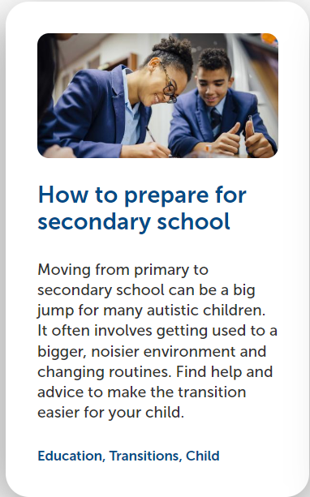
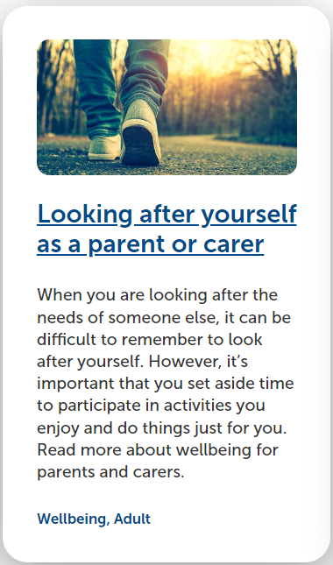
Part One - The website
Autism Central for Parents and Carers | Autism Central
A growing source of information and guidance for parents and carers

Slide 5
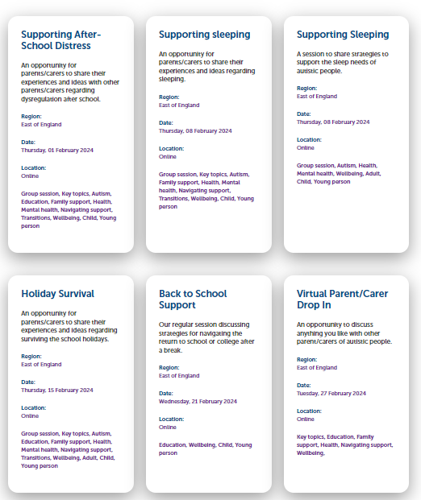

Part 2: Personal support via group online sessions & 1:1 calls
Parents/carers can scan the QR code to register for a 1:1 telephone call. The average wait time is less than one week.

Slide 6


To change image:
Delete existing image and insert new by clicking on icon
or
Right-click, change picture
If new picture causes placeholder to resize or rotate
Click on ‘Reset’ under ‘Slides’ tab on Ribbon
To resize or reposition image within placeholder:
Picture Format> Crop
Resize using white circles at corners
Move by click+hold on grey area of image then drag to position
Part 3 – Face-to-face events
Nurseries, Schools and other groups can request Peer Educators to attend family/carer events.
If you would like a visit, please email:
peersupporthub@essex.gov.uk

Slide 7
The story so far:
Over 500 Parents/ Carers have received 1:1 Support
You have given me so much hope, thank you!
The relief I felt from talking to other parents who understand is overwhelming.
Over 300 Parents/ Carers support in group sessions
Over 50 events supported in person by Peer Educators
It was so helpful and just gives parents and professionals a place they can share and gain feedback.

Slide 8


This information is issued by: Essex County Council
Contact us:
peersupporthub@essex.gov.uk
Essex County Council County Hall, Chelmsford Essex, CM1 1QH
Essex_CC
facebook.com/essexcountycouncil
The information contained in this document can be translated, and/or made available in alternative formats, on request.
Published September 2023

