Slide 1

Maltese Road Primary School
2024-2025

Slide 2
Start/Finish times
School gates open at 8:30am for pupils to arrive and enter their classrooms.
All pupils should be in class by 8:40am and this is the official start of the school day.
Due to insurance purposes, children are not permitted to play on any school equipment after school.
The gate will be locked 3:20pm sharp so please make sure you are off the playground by then.
Please note that staggered finish times are in place to help manage traffic congestion and parking in Maltese Road.
Reception class finish at 3pm
Year 1, Year 2, Year 3 and Year 4 classes finish at 3:10pm
Year 5 and Year 6 classes finish at 3:15pm

Slide 3
Walking Home From School
Children need to have permission to walk home from school by themselves.
Mobile phones should be handed to the class teacher at the start of the day and will be returned at the end.
Please telephone the school by 2.30pm at the latest if you are delayed or if there is a change of arrangement when collecting your child from school.

Slide 4
Homework/ Reading
Half termly Writing Bingo will be sent home as well as the spelling rules that children will cover.
Spellings will then also be put on Spelling Frame if children would like to practise these.
Maths and English worksheets will be sent home weekly.
Reading: Children are expected to read at least 3 times a week. This should be recorded in their Reading Diaries, dated and signed by an adult. Reading Diaries should be brought into school to be checked (on a Thursday in Year 6). Reading certificates are awarded for KS2: Bronze (50 reads), Silver (100 reads), Gold (150 reads) and Platinum (250 reads).
Remember to keep playing on Times Tables Rockstars to increase speed and fluency. (Tackling Tables test on a Wednesday)
Homework is set on a Friday and is due in the following Wednesday.

Slide 5
Positive Behaviour Policy
Please see school website for full Positive Behaviour Policy.
Make Great Choices!
Our recognition board and Magnificent Malteser are linked to school values:
Creativity | Respect | Compassion | Co-operation | Responsibility | Courage | Resilience

Slide 6
Reward systems
Dojos will be awarded to children when adults notice children making great choices. These will be turned into house points at the end of each week.
The class are able to vote to ‘spend’ their dojos on a treat from their wish list or roll them over until they have the amount they need for a particular treat.
Magnificent Malteser to be awarded in line with the Maltese Road school values. These will be awarded every Friday in celebration assembly and a certificate will be sent home.

Slide 7
Uniform
The school uniform is:
Grey trousers or skirts/pinafores, plain white shirts, grey jumper with school logo and school tie.
In the summer, children may wear grey school shorts or a green and white checked summer dress. Socks should be white or grey and may be knee or ankle length.
Please ensure all items of clothing are clearly named.

Slide 8
PE kit
An email went out on Monday which has hopefully answered some questions and concerns with regards to getting changed for PE in school.
black/green bottoms
white polo/t-shirt
black/white plain trainers
green/black jumpers
Earrings should be removed for PE.
Long hair should be tied back.
Our PE days are: Mondays and Fridays
For Autumn 1 only, PE days will be Tuesdays and Fridays.

Slide 9
Snack
Children are encouraged to bring in a water bottle each day (water only)
Children are welcome to bring their own healthy snack into school. Please refer to the school’s Food Policy which can be found on the school website.
No chocolate, biscuits, crisps, nuts (we have several children and adults in school with severe nut allergies), etc.
Suggested healthy snacks include:
Fruit such as bananas, apples, grapes, tomatoes, etc
Raw vegetables such as carrots, peppers, etc
Cereal bars

Slide 10
School equipment
Please ensure children have small backpacks or book bags as storage in class is limited.
All children should have water bottles.
No pencil cases or drawing equipment please.
Occasionally we may ask children to bring in items to support their learning e.g. for DT such as empty cardboard boxes/ wools/ fabrics, etc.

Slide 11
Year 6
Class teachers
Mrs Dawson-Goodey (Monday-Wednesday)
Mrs Millwood (Thursday-Friday)
Topics
The Tudors, Ancient Egypt, Industrial Revolution & Our Changing World
SATS
- Monday 12th May – Thursday 15th May
- 3 English tests (Reading, Grammar & punctuation and Spelling)
- 3 Maths tests (Arithmetic, Reasoning 1 & 2)
- In addition to covering the National Curriculum Objectives in lessons, we will also complete a range of practice papers, booster groups, revision sessions and CGP activity books.
- More information to follow
Residential
- Mersea Outdoors
3 days, 2 nights (Summer Term)
11th-13th June
- Information meeting to follow

Slide 12
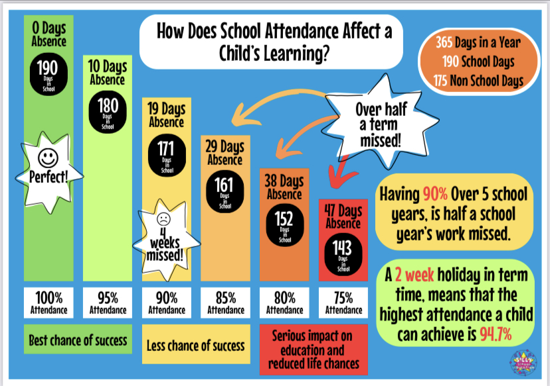
Attendance

