Slide 1
Maltese Road Primary School
KS2
2024-2025

Slide 2
PE kit
Year 5 PE days before half-term are:
Tuesday and Friday.
Year 5 PE days after half-term are:
Monday and Friday.
Black/green bottoms
White polo/t-shirt
Black/white plain trainers
Green/black jumpers
Earrings should be removed on PE days.
Please ensure children come into school in the correct PE kit on their PE days.
If children do not have the correct PE kit they will not be able to take part in PE due to health and safety.

Slide 3
Start/Finish times
School gates open at 8:30am for pupils to arrive and enter their classrooms. All pupils should be in class by 8:40am as this is the official start of the school day.
Year 5 finish at 3:15.
If children are not collected by 3:15pm, they will be sent to the library. Children must be collected by an adult in autumn and spring terms. They can begin to walk home by themselves in the summer term.
No MUGA play or climbing frame after school due to insurance.
Please note that staggered finish times are in place to help manage traffic congestion and parking in Maltese Road.

Slide 4
Class teachers
Mrs Millwood will teach the class on Wednesdays.
Mrs Farrell will teach the class on Tuesday afternoons.

Slide 5
Homework/Reading
All children will receive:
Half termly writing bingo which will include activities linked to writing skills the children have been learning in school.
Spellings to practise on the back of the bingo sheet. These will be tested during dictated sentences on a Thursday.
Maths will be set weekly on PurpleMash. You will not be able to access the work until after 4pm.
Children are expected to read at least 3 times a week and this should be signed by an adult in their reading log. Bronze, Silver, Gold and Platinum certificates will be awarded for reads at home.
Optional Nandos homework grid.
Homework will be set on a Friday, and expected back in on a Thursday.

Slide 6
Books coming home
Colour reading book
Children will bring home a colour reading book. This is a book which is at the level which children have been assessed at. The assessments completed in school to assign a colour consider children’s ability to comprehend the text, as well as to read the text.

Slide 7
Positive Behaviour Policy
Please see the school website for our full Positive behaviour policy.
Make Great Choices!
Our recognition board and Magnificent Malteser are linked to our seven school values.
Creativity | Respect | Compassion | Co-operation | Responsibility | Courage | Resilience

Slide 8
Reward systems
Dojos will be awarded when adults notice children making the right choices. These will be turned into house points at the end of each week.
Magnificent Malteser to be awarded in line with the Maltese Road school values. These will be awarded every Friday in celebration assembly and certificate will be sent home.
Reading certificates to be awarded during celebration assembly.

Slide 9
Uniform
The school uniform is: grey trousers/skirts/pinafores, plain white shirts, grey jumper with school logo and school tie.
In the summer, children may wear the green and white checked summer dress. Socks should be white and may be knee length or ankle.
All items of clothing should be clearly named.

Slide 10
Snack
If children would like to bring a snack in for break time, please ensure this is a healthy snack (no chocolate, biscuits, crisps, nuts etc).

Slide 11
School equipment
Please ensure children have school book bags or small backpacks.
Children should be bringing in their reading book and reading records into school everyday for adults to check.
All children should have a named water bottle.
No pencil cases are needed at school.

Slide 12
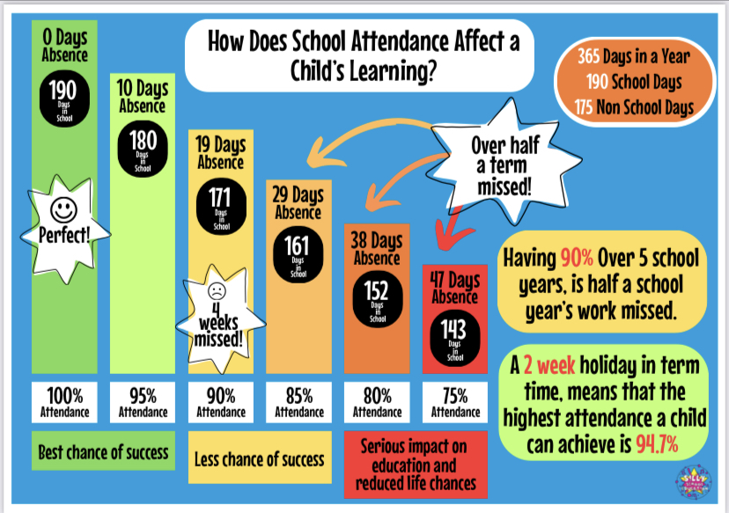
Attendance

Slide 13
Thank you for coming.
Please check the weekly newsletter and class dojos for any other information.
All of the information on this PowerPoint can be found on our class page.

