Slide 1
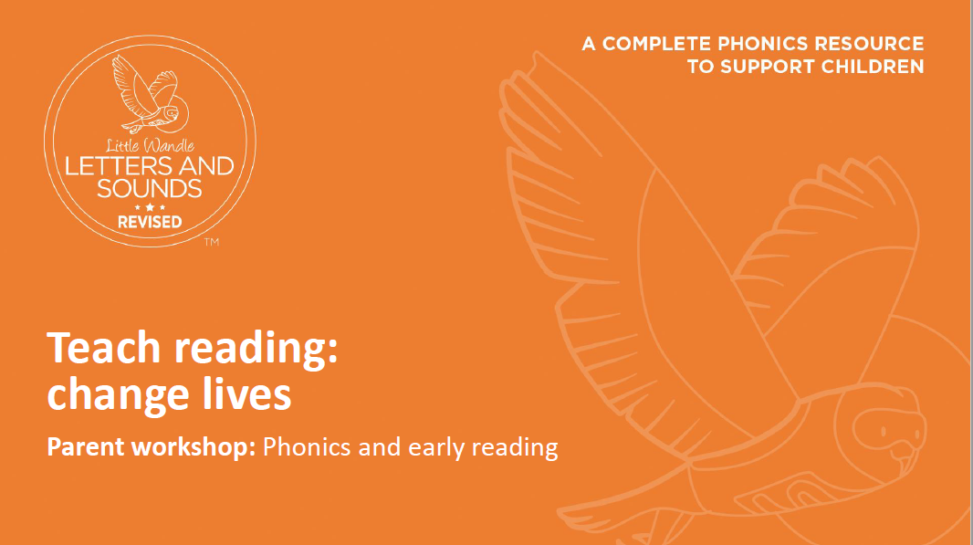

Slide 2
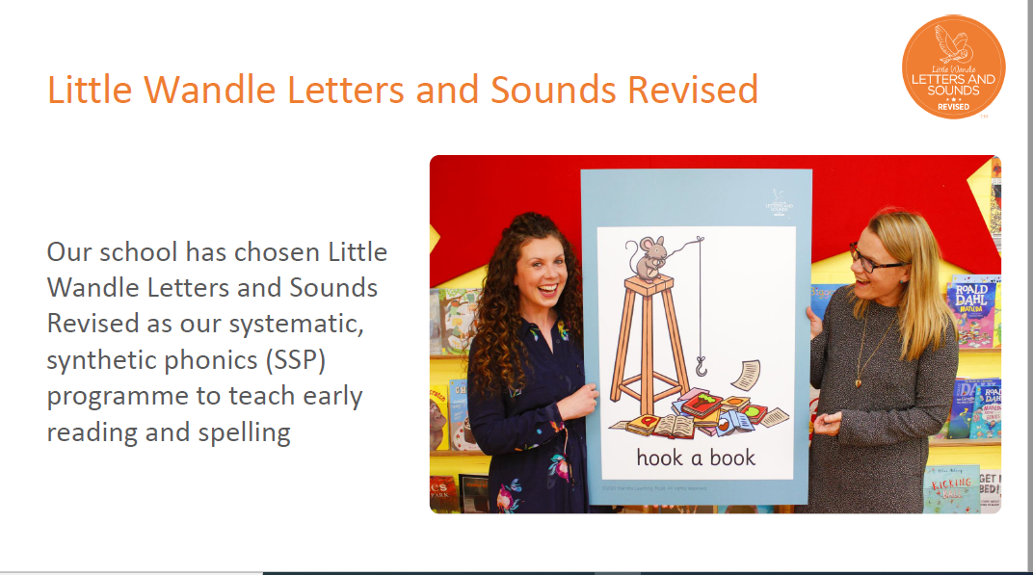

Slide 3
When is phonics taught?
Phonics is taught everyday in Reception and Year 1.
Phonics continues into the beginning of Year 2 and then moves onto spelling and grammar.
Catch up sessions also take place during the week for pupils who need extra support with phonics.

Slide 4
Lesson Example
https://player.vimeo.com/video/554408809?rel=0

Slide 5

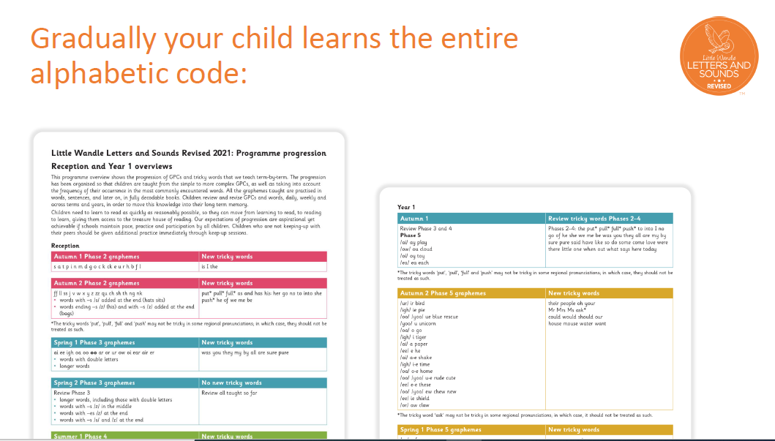

Slide 6
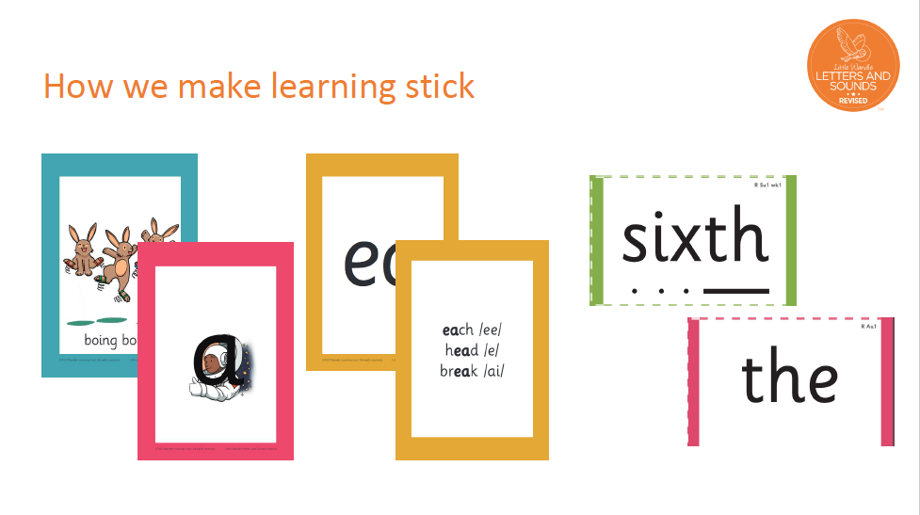

Slide 7
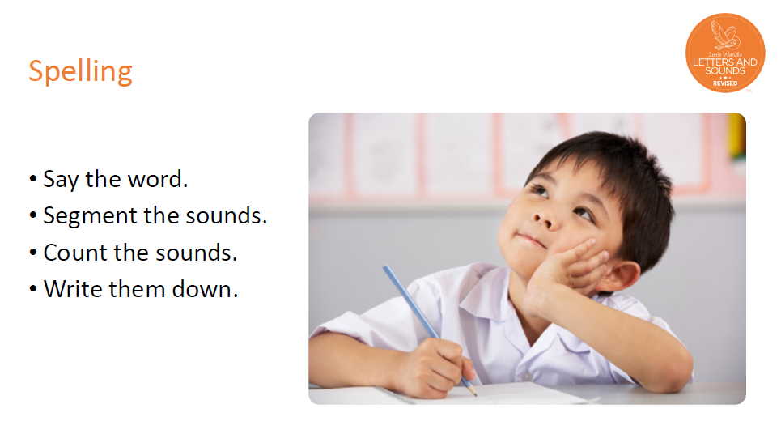
Daily phonics session also include spelling

Slide 8
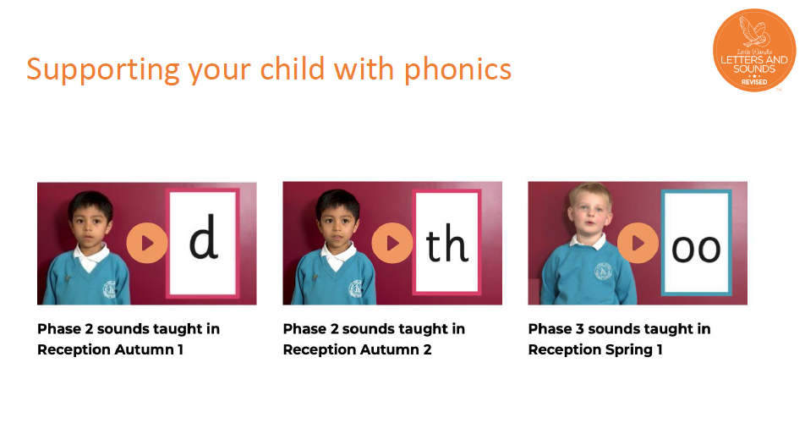
https://www.littlewandlelettersandsounds.org.uk/resources/for-parents/

Slide 9
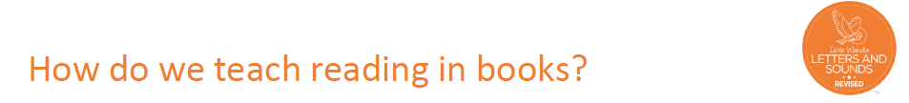
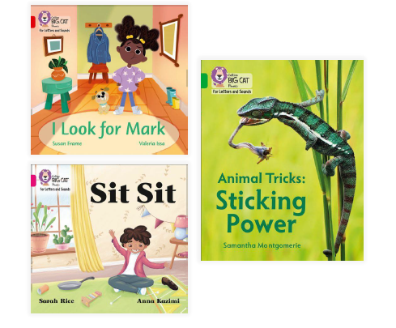
Reading practice sessions are:
taught using fully decodable books matched to the children’s ability
timetabled three times a week in Reception and two (slightly longer) sessions in Year 1.
taught by a trained teacher/teaching assistant
taught in small groups

Slide 10
Each session has a different focus
Session 1 – Decoding
Session 2 – Prosody
Session 3 – Comprehension

Slide 11
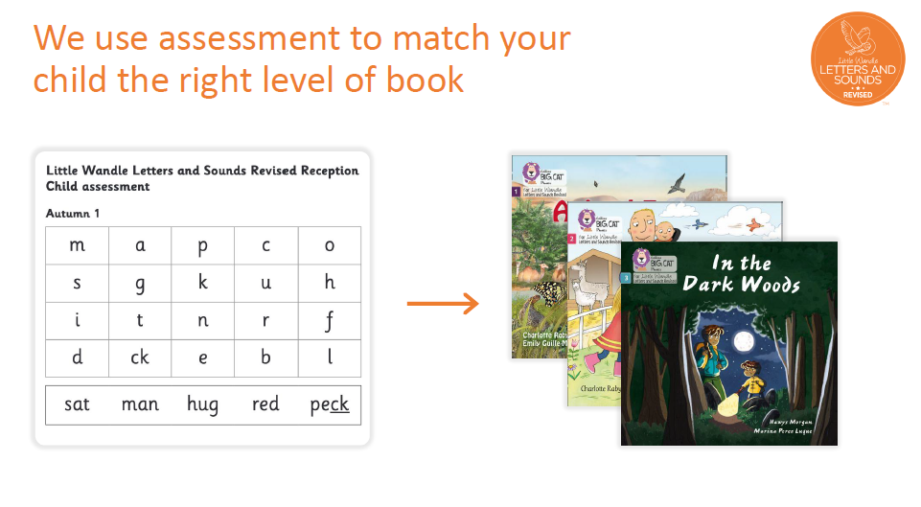

Slide 12
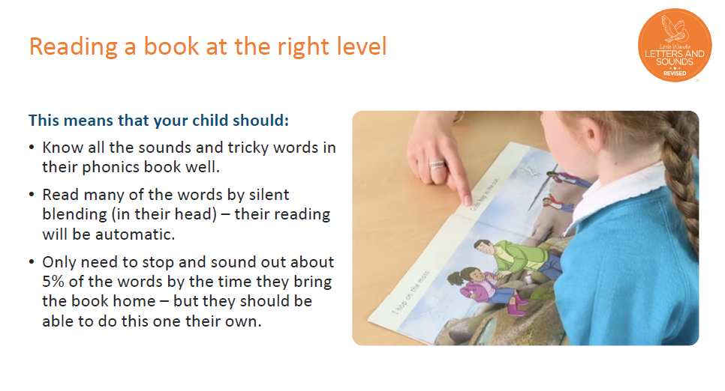

Slide 13
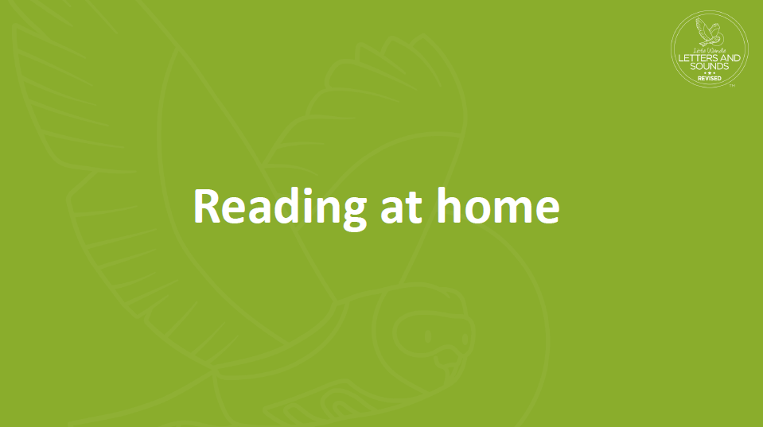

Slide 14

Books coming home
Once the children are reading this book fluently in school, they will bring it home to read to you. They should be able to read this fluently so please do not worry if they don’t need your help!
If your child cannot read a word, encourage them to sound it out. If they still cannot read the word, tell them what it says.
Talk about the book and celebrate their success.

Slide 15
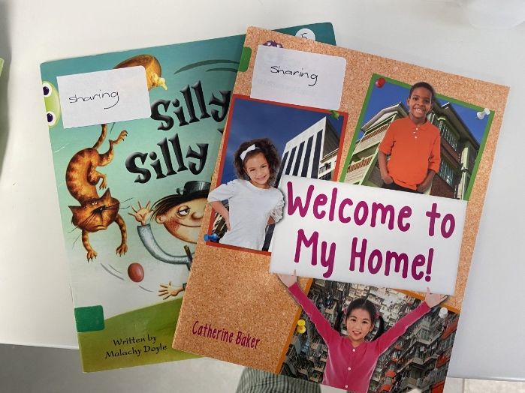
Sharing books
The children will also bring home a ‘sharing book’
that they have chosen to read with you.
These books are for you to read together.
These books have been closely matched to your child’s phonics ability but may contain a few sounds and tricky words which are unfamiliar to them. If they come across something they are unsure of, please tell them what it says.

Slide 16
It is really important that these books are returned to school as we will not be able to teach the group reading sessions without a full set of books.
Your class teachers will let you know which days books will be going home and when they need to be back in school.

Slide 17
