Slide 1


www.sendsensation.co.uk
www.sendsensation.justgo.com

Slide 2








Who we are?
SEND Sensation is a partnership of locally trusted organisations that provide clubs and activities for children and young people with special educational needs and disabilities across Mid and North Essex.
Core Partners:

Slide 3
What we do?
Support children and young people from their early years to their 19th birthday with learning disabilities and autism, physical and sensory impairments, special educational needs and disabilities.
#Local #Accessible #Positive
Local Access – to community clubs with a choice of locations and times that are age and need appropriate.
Accessible Navigation – clear information and guidance to support families and allow them to easily access their local provision.
Positive Experiences – with a range of community clubs and activities covering venue-based clubs and community-based activities. All with the aim of providing children and young people with the opportunity for:
  Personal development
  Educational development
  Social development

Slide 4
Our Partnership
Greater Choice & Opportunity
Working together, enables us to offer children and young people choice and opportunities across multiple settings. Empowering them to develop and transition as they explore and grow with different clubs, activities and age categories; from the early years right through to the transition to adulthood.
Greater Expertise
Whilst each partner has their own specialities and areas of expertise, we work together to offer support and guidance, sharing best practice across the partnership.
Leading the Way
Using the partnerships collective wealth of knowledge and experience, along with established connections, we can support families more holistically. Looking to lead the way with support and advice, not just for the children and young people, but also their parents, siblings, school settings, support groups and beyond.

Slide 5
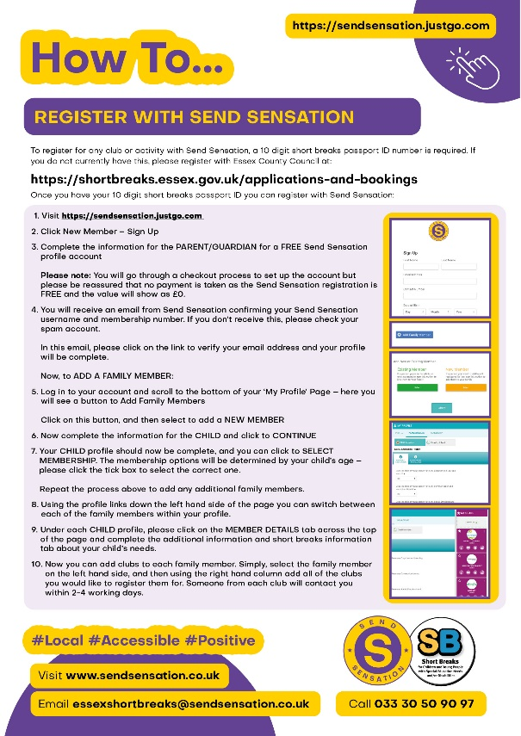
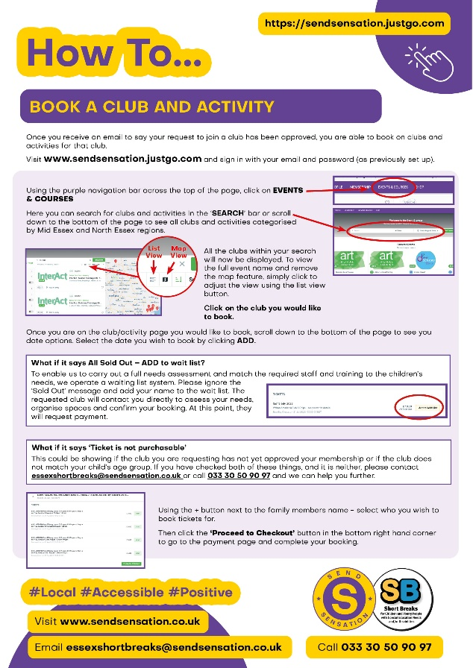
How Children & Young People Access
Short breaks passport ID from Essex County Council
0 – 19th Birthday
Live within Essex County Council borders
Have a diagnosis of special educational needs and/or a physical disability.
Register online at www.sendsensation.justgo.com
How to guides can be provided

Slide 6
The Process
Registration form completed online with the SB passport ID
Issued a Send Sensation membership number
Add clubs to your profile
Clubs will contact to carry out individual needs assessment
Club approval
Book clubs and activities & enjoy!

Slide 7

Timetable

Slide 8
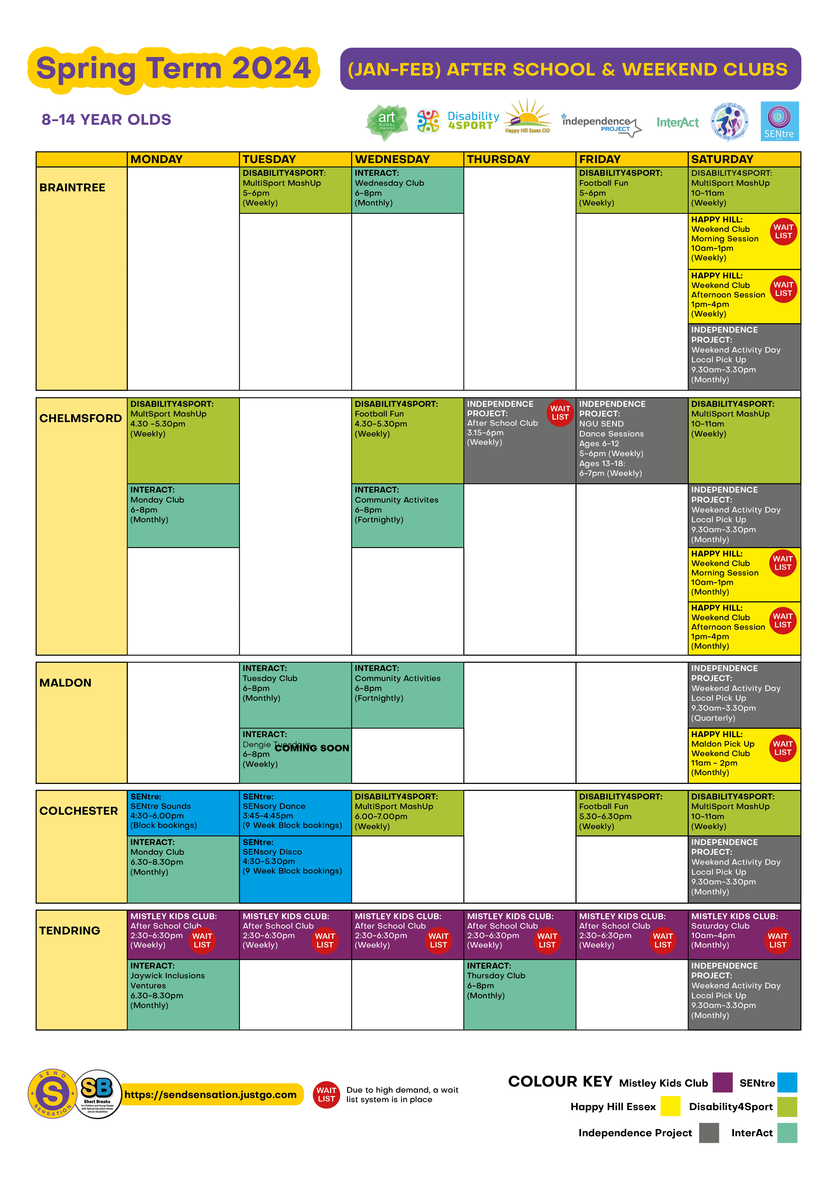

Timetable

Slide 9
More Information...
www.sendsensation.co.uk
essexshortbreaks@sendsensation.co.uk
Tel: 033 30 50 90 97

