Slide 1

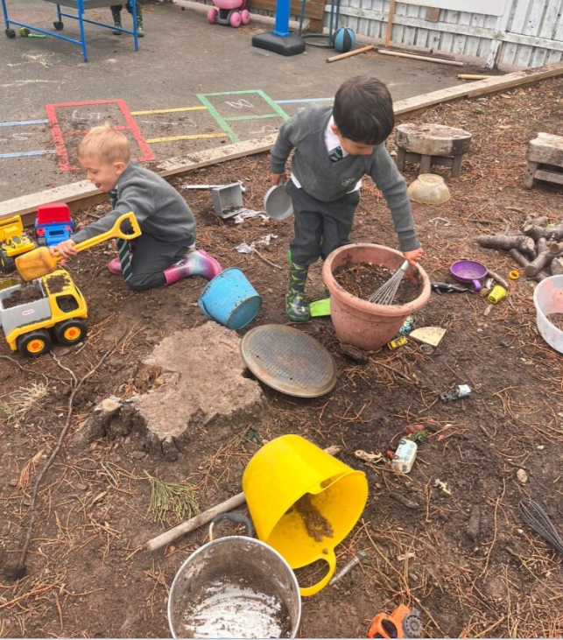
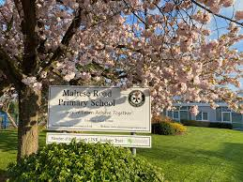
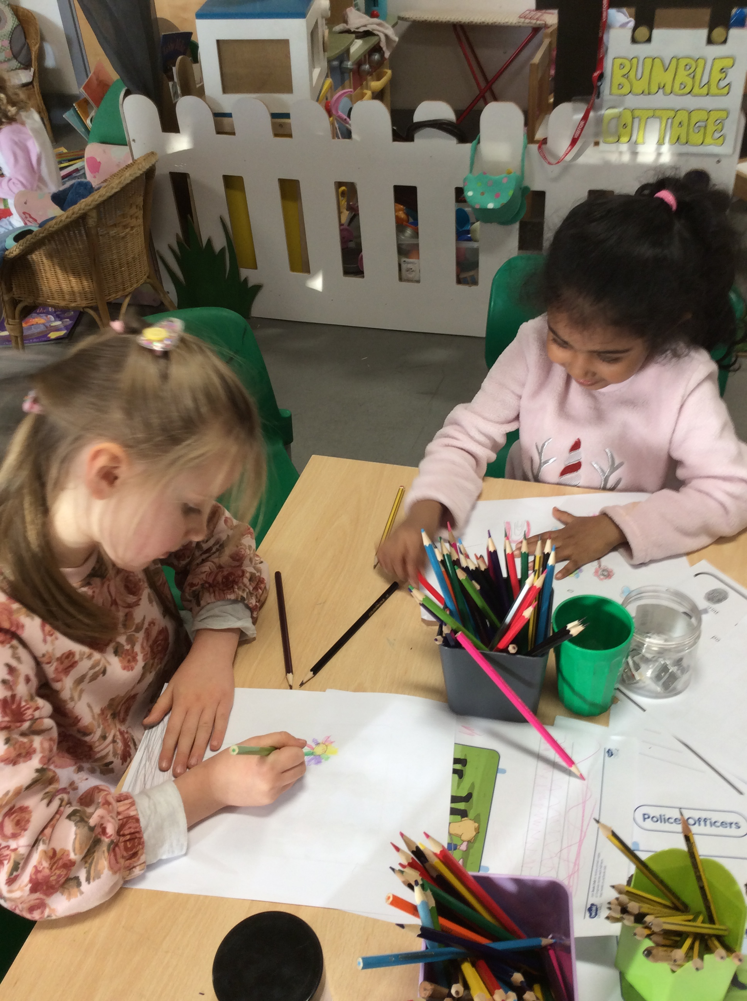
Wednesday 19th November 2025 Maltese Road Primary School
OPEN AFTERNOON
Find out why Maltese Road is such a special place!
Maltese Road Primary School
Headteacher: Mrs Faye White
SENCo and Senior Leader KS1: Mrs Grace Almond
Senior Leader KS2: Mrs Lauren Strong

Slide 2
🏫 About Our School
One-form entry primary school – one class per year group from reception to year 6.
Capacity: 210 pupils – 30 per year group
Warm, inclusive, community-focused environment – Maltese Road has been established for 10 years and look forward to celebrating this milestone.
Ofsted rating a strong good
High expectations for every child:
ELG – Yr R
Y1 Phonics
End of KS2 SATs results
Number of children in the Class | No/% at GLD by the end of the year
29 (with severe SEN needs band 6) | 21/72%
Number of children in the Class | No/% at Required Level (32)
30 (4 children with severe SEN needs) | 23/77%
 | Number of children in the Class | No/% at ARE+ by end of the year | No/% at GD+ by end of the year
Reading | 31 | 24/78% | 18/58%
Writing | 31 | 25/81% | 6/19%
Maths | 31 | 27/87% | 18/58%
RWM | 31 | 24/78% | 6/19%

Slide 3
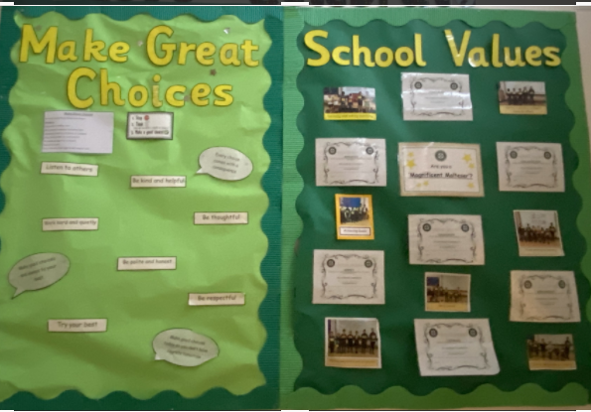
Our Vision and Values
Inspire Achieve Learn Together
At Maltese Road we aim to:
Foster curiosity, creativity, courage, resilience
Encourage compassion, respect, responsibility and aspiration
Help every child reach their potential in a caring environment
Make Great Choices

Slide 4
Our Aims and Ethos
We want our children to be happy, healthy and successful, to enjoy learning together and to understand the meaning and importance of upholding principles and values.
We will:
• Create a happy, safe and caring environment
• Value each child for his or her individual talents
• Help our children to learn about courtesy, good manners and consideration for others
• Promote positive relationships between pupils and adults
• Encourage children to wear their uniform with pride
• Prepare our pupils for the responsibilities and experiences of life Britain and the wider world

Slide 5
🏫– Our Multi-Academy Trust
We are proud to Be Part of Quantum
Our Trust includes 8 schools:
  7 primary schools (3 in Chelmsford)
  1 secondary school in Great Baddow
Shared vision of excellence, collaboration, and community
Access to shared resources, specialist training, and wider enrichment opportunities

Slide 6
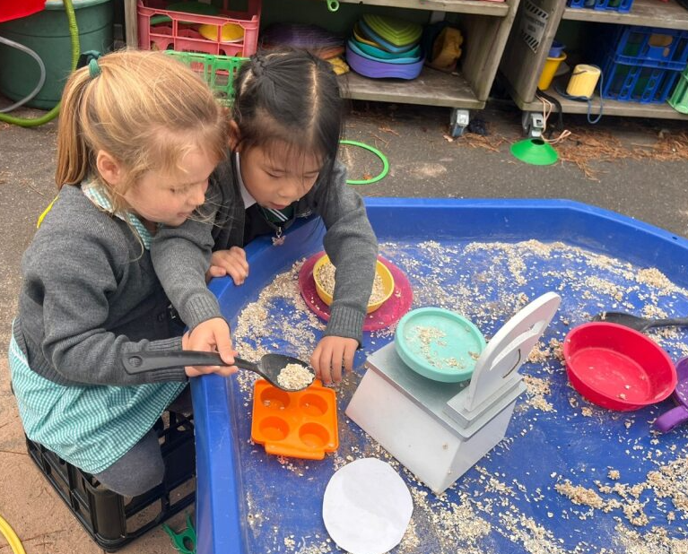
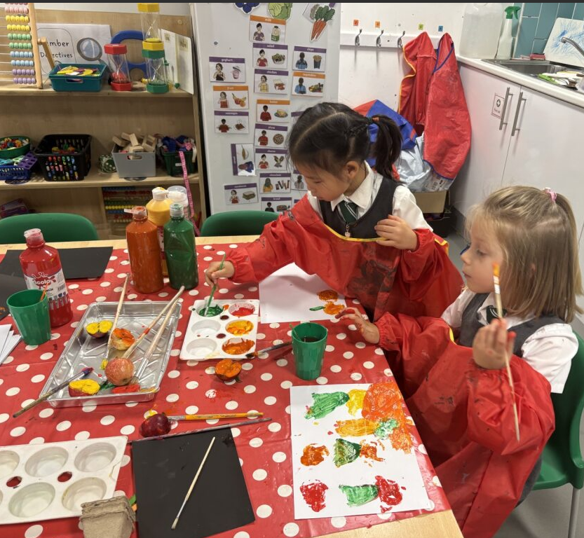
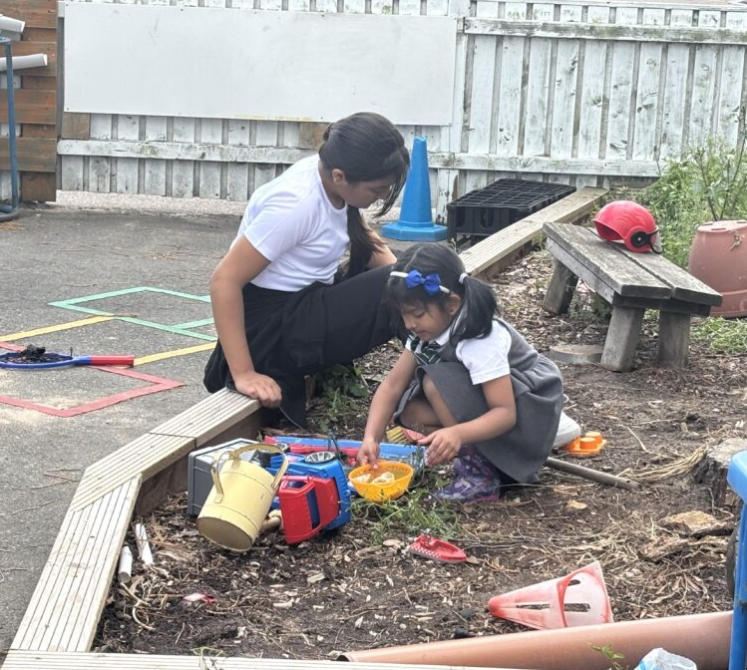
👧🧒 The Reception Year
A gentle, joyful start to school life
Learning through play, exploration, and curiosity
Building early literacy, maths, and social skills
Developing independence and confidence

Slide 7
🎓 Our Curriculum – Supporting Every Child to Shine
Our curriculum is designed to challenge, support and inspire — whatever a child’s starting point.
We provide:
🌱 Personalised Support – targeted teaching and small-group work for children working towards age-related expectations.
🚀 Challenge for the More Able – deeper thinking, problem-solving, and opportunities to lead learning.
💬 Engaging Lessons – creative, broad curriculum linked to real-life contexts.
🤝 Inclusive Learning – every pupil feels valued, encouraged, and part of our learning community.
“Our goal is to help every child reach their potential — academically, socially, and emotionally.”

Slide 8
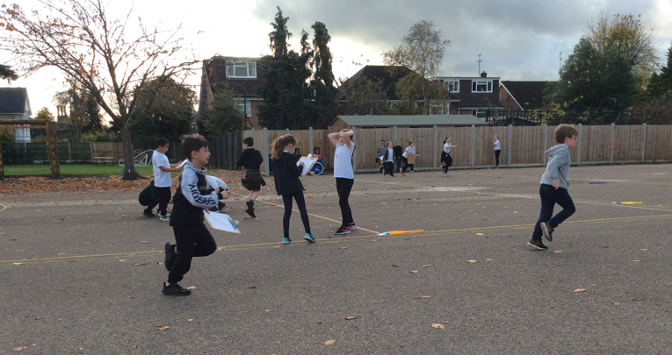
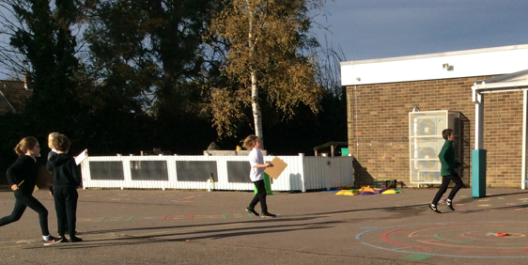
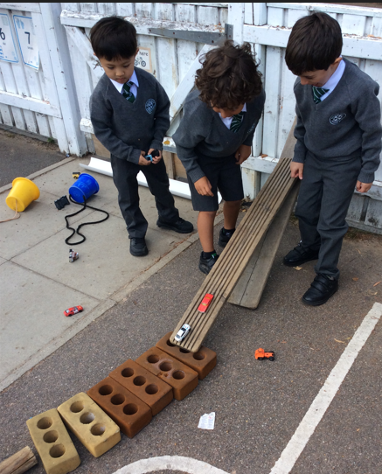
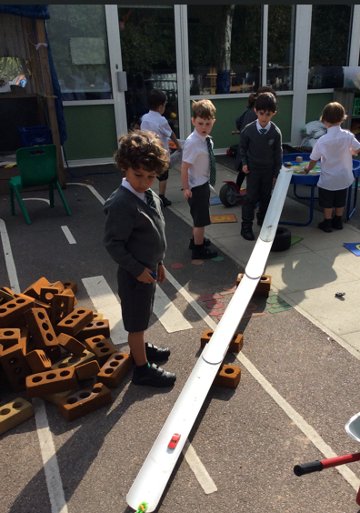
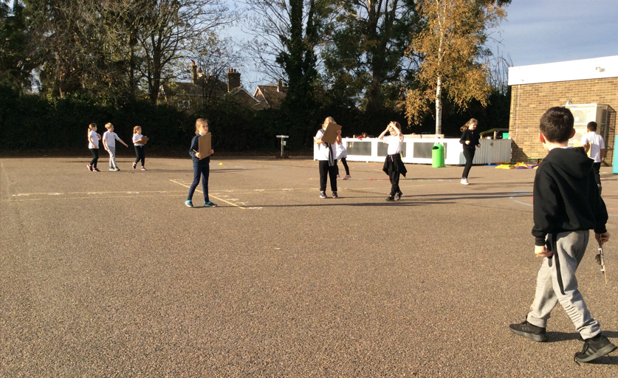
🏫 A Typical School Day
Warm welcome each morning
Daily phonics, maths, and topic-based learning
Outdoor learning every day
Assemblies and celebrations with the whole school
Lunchtime play, creative arts, and story time

Slide 9
❤️ Wellbeing and Care
Every Child Matters
Supportive, inclusive ethos
Staff trained in emotional wellbeing and safeguarding
SENCo and pastoral team available for support
Restorative approaches to behaviour and relationships

Slide 10
👨‍👩‍👧 Working in Partnership with Parents
Open communication and strong relationships
Regular updates and opportunities to get involved
Parent workshops, reading mornings, and family events
“Together we help your child thrive.”
Parents supporting children with homework

Slide 11
🎉 Enrichment and Opportunities
Clubs and activities: art, sport, music, coding, choir
Celebrations and performances throughout the year
Educational trips and themed learning days
Links with our Trust schools for shared experiences

Slide 12
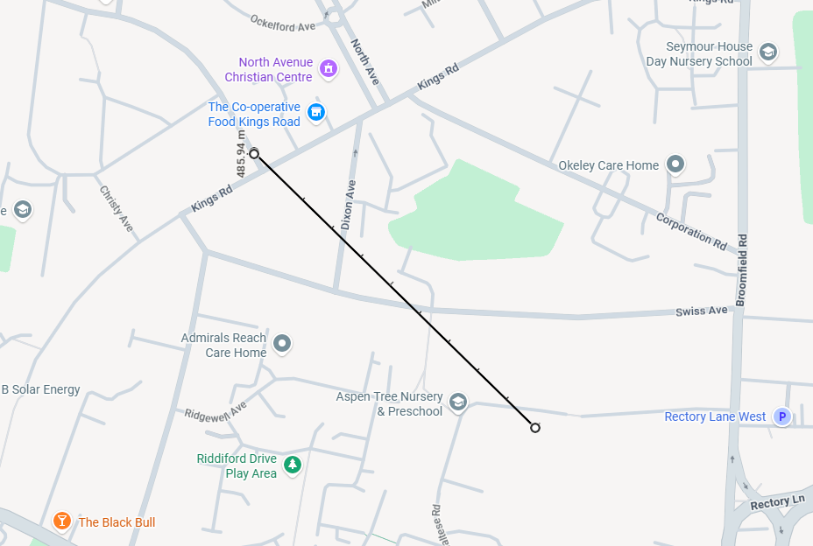
📝 Admissions and Next Steps
Apply through your Local Authority
All schools have published admission criteria set by local authority.
We have places for 30 children each year, prioritised by:
a) in care or being looked after is top priority
b) who have a brother or sister at the school already, although not if they are currently in Y6 when applying. This year there could be between 10-13 siblings.
c) straight line distance from home to school. Last place offered was 0.54miles (straight line distance)
To apply for a place at our school,
please use the link https://www.essex.gov.uk/admissions
Applications open September 2025 – close 15th January 2026 All applications received after 15 January will be treated as late and will only be processed after all on-time applications. You must apply for at least 3 schools.
Offers announced in April
Induction events and “Stay and Play” sessions in the summer term

Slide 13
💬 Questions and Tour
“We’d love to show you around!”
Tour of Reception classroom and outdoor area
Chance to speak with staff and ask questions
🌈 Thank You
Thank you for visiting Maltese Road Primary School.
We look forward to welcoming your child to our school community.

