Slide 1

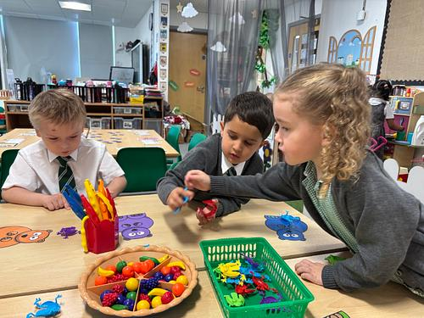
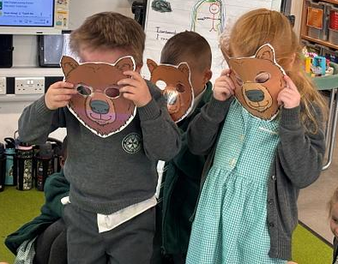
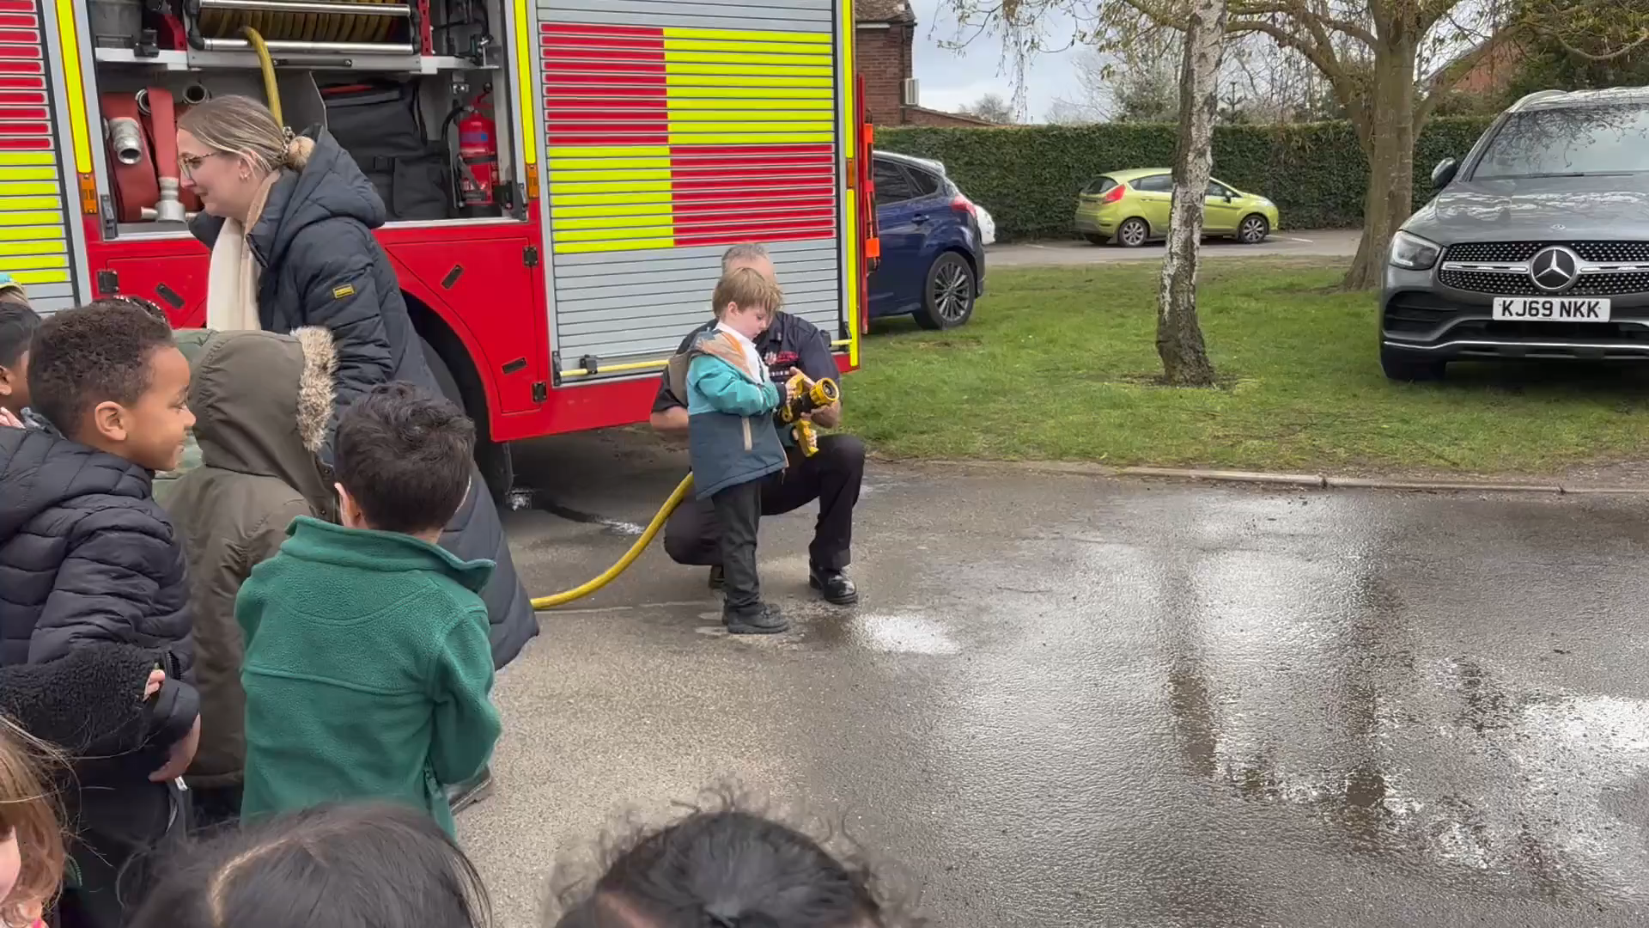

Welcome to
Maltese Road Primary School
Notes:
Welcome, thank you all for coming. Lovely to see you again.

Slide 2

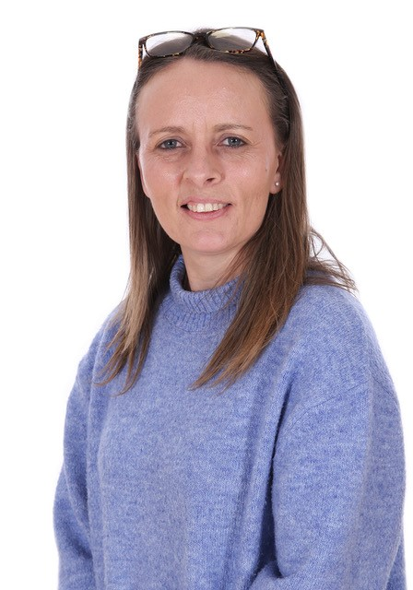
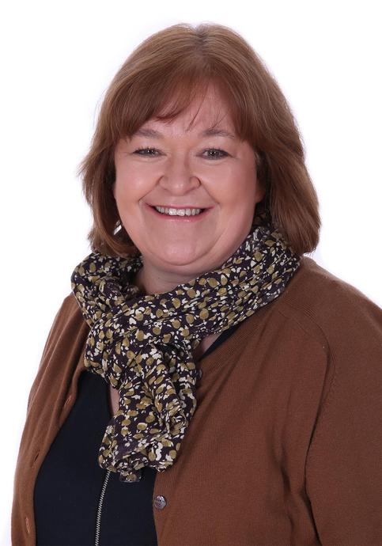
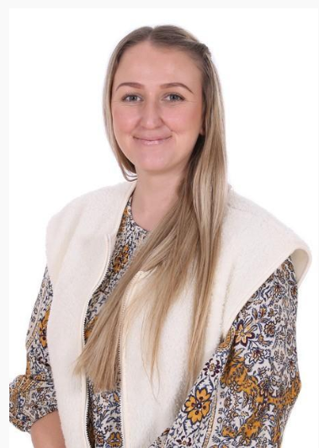
Welcome to EYFS
Maltese Road Primary School
Notes:
Welcome, thank you all for coming. Lovely to see you again.

Slide 3

Introductions
Mrs White (Headteacher)
Mrs Almond (Senco)
Mrs Ingram (Class Teacher)
Mrs Story (Higher Level Teaching Assistant)
Mrs Dade (Learning Support Assistant)
Mrs Cooke (Office Manager)
Mrs Ireland (Admin Assistant)

Slide 4
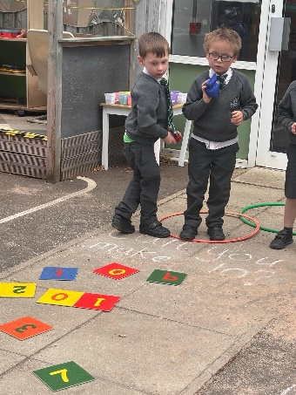
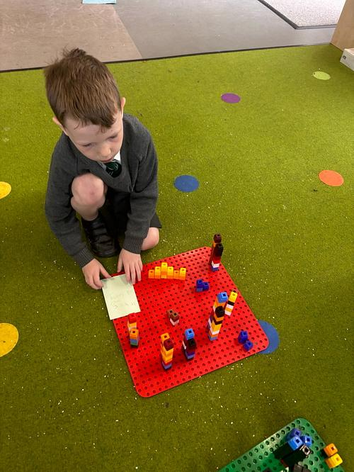
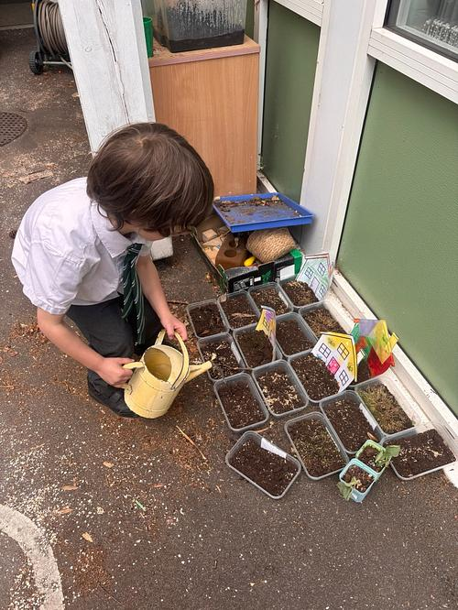
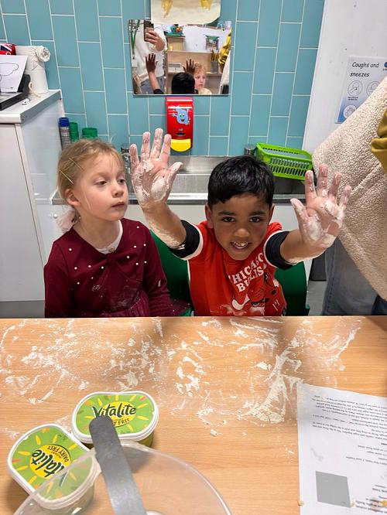
What is EYFS? The Early Years Foundation Stage (E.Y.F.S.) is the stage of education for children from birth to the end of the Reception year.
It is based on the recognition that children learn best through play and active learning.
What is EYFS?

Slide 5
We want your child to…
Develop a love for learning
Be safe and happy!
Form positive relationships
Create independence
Develop resilience and problem-solving
Be creative learners
Notes:
- 1st year at primary school most important = happy!
Work hard to quickl;y develop strong relationships
Transition to building is smooth – sharing photos and progress, talking
- Many children’s favourite year is Reception - learn through play & don’t realise learning!
- Skilled teachers & TAs - challenge and move learning on
-

Slide 6
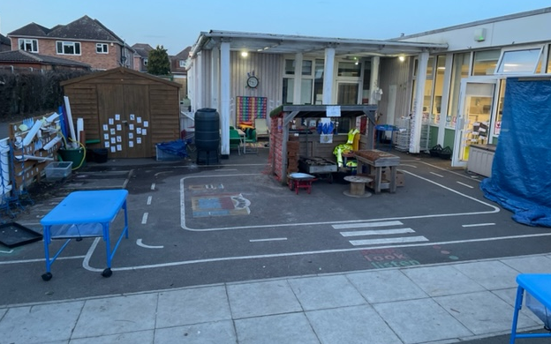
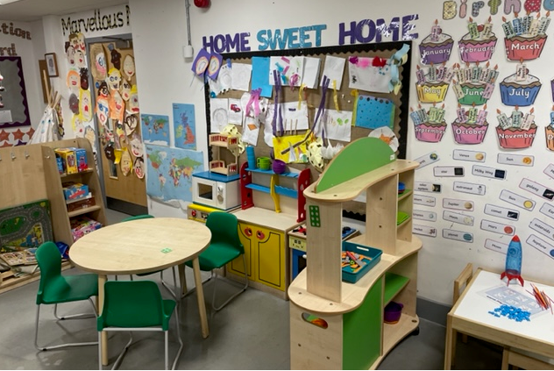
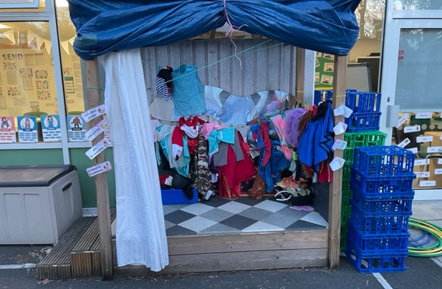
Our Reception Classroom
Learning through play
Opportunities to explore and investigate
Developing independence and thinking skills
Notes:
Self contained! Inside & outside classroom, with equal importance. Chn can freeflow for most of the day. Classroom set up in different areas and zones. Reading area, creative workshop, snack area, ICT, maths, role play etc. Organised in a way that all resources are accessible to chn to develop independence and facilitate learning in the absence of an adult.

Slide 7
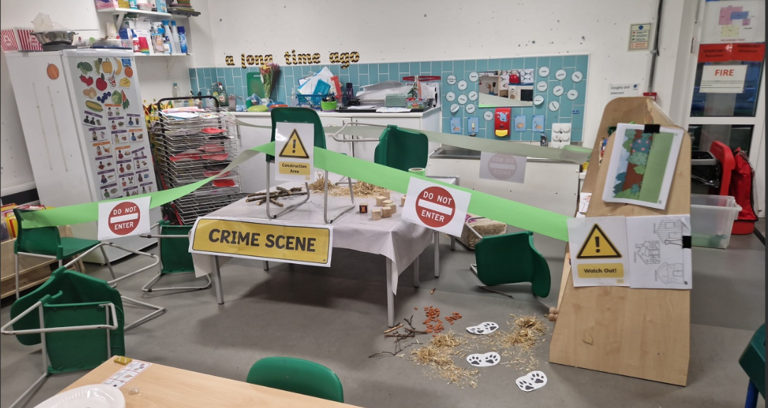
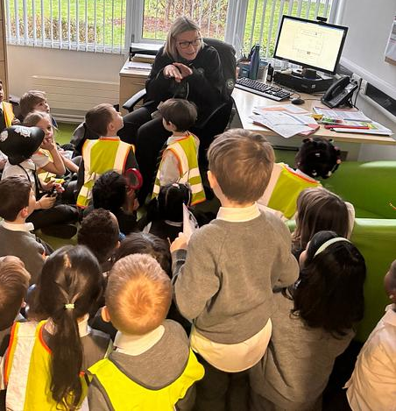
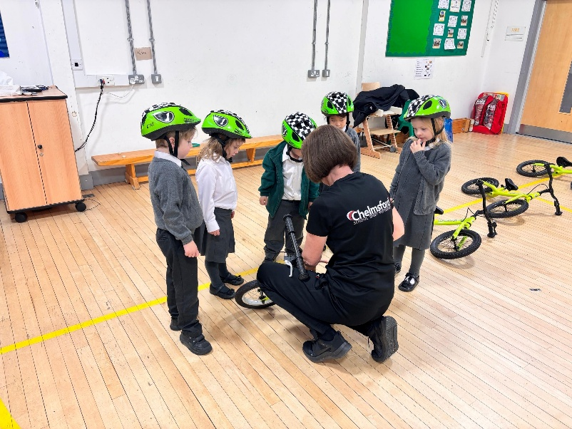
Examples of some hands-on learning in the classroom.

Slide 8
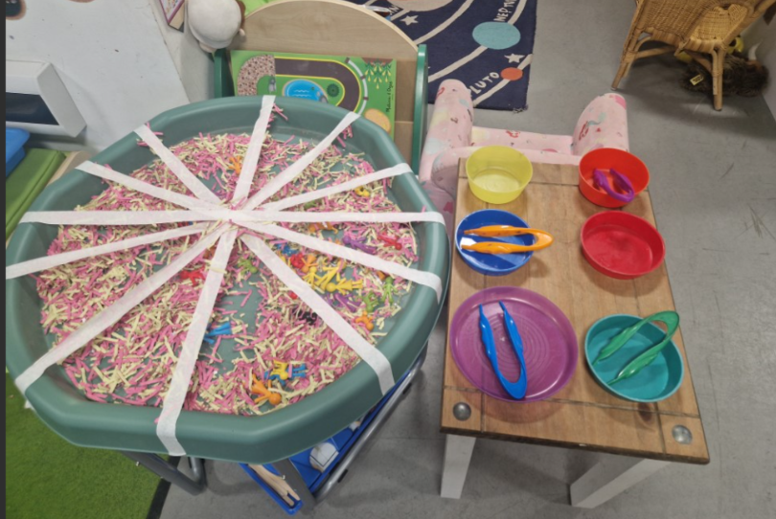
Fine motor skills – cross-curricular links with maths, communication and language.

Slide 9
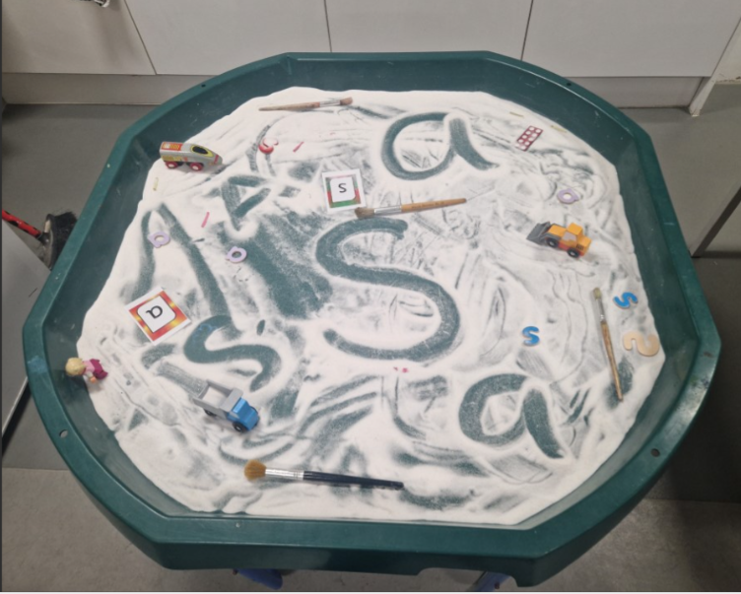
Fine motor skills – cross-curricular links with literacy, communication and language.

Slide 10
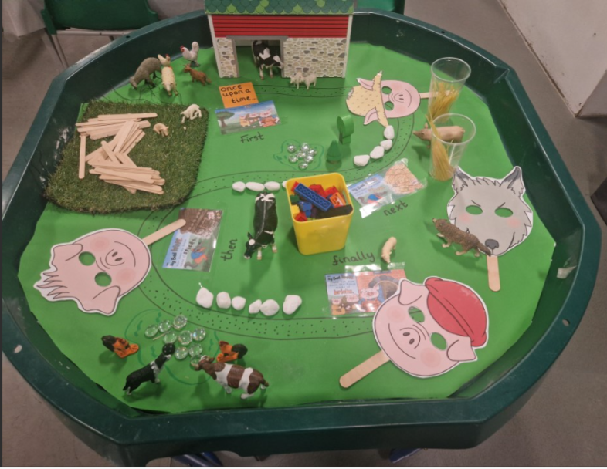
Story telling trays – Links to maths, Understanding the world, communication and language, PSHE, PSED.

Slide 11
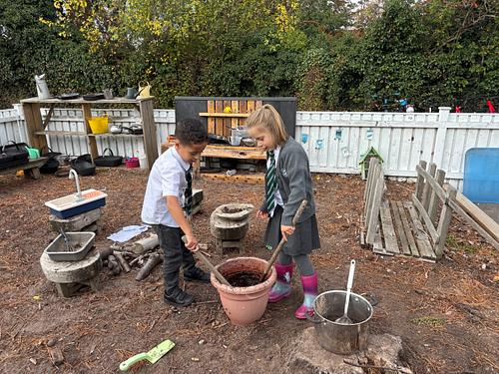
Learning Focus
The focus in the first term is on communication and language skills, and the characteristics of affective learning.
Active, engaging, and thinking activities.
But most importantly, the social communication and interaction is prime focus in order for the children to successfully access other the areas of the curriculum .
Notes:
Timetable changes throughout the year depending on the needs of the children
8.45 - Gate opened at - say goodbye & straight into classroom
9.00 - Gate locked – after this go to office
Less formal reg to settle them etc
Welcome songs, calendar, gross motor skills with dance/MM then a short, pacey, engaging direct teach
Time to explore – independent, challenge – CT/LSA working with sm grps, 1:1 or interventions as nec
Snack – ECC provide fruit/milk
We ask for £1/week contribution towards snack that will be prepared/cooked by groups of chn each day.
Something healthy like cheese & crackers, banana muffins etc Opp to try new foods, basic skills, maths, language, social (progression from nursery)
Hand to Miss S on Monday morning (start on first full week)
Snack in circle
12.00 - Lunch time.
Entitled to free school meal
Menus online week before or can request a paper copy from office
Can bring packed lunch if wont eat meal
Usually eat different foods in school than they might at hom
FMS – Dough Disco – youtube!
3.00 - Unlock gates
3.05 - Please wait outside classroom to be matched
Please let us know if somebody dif – ring ahead

Slide 12
A typical day in Reception in the first term.
 | Timetable
8.30 | Self-register, explore and learn or groovy groups
9.00 | Phonics – Little Wandle
9.20 | Rolling snack and explore and learn time
11.10 | Fun with numbers
11.45 | Lunch
12:50 | Ready regulate and afternoon register
1.00 - 2.30 | Explore and learn and Individual reads.
2.50 | Story and Rhyme time.
3pm | Home
Notes:
Timetable changes throughout the year depending on the needs of the children
8.45 - Gate opened at - say goodbye & straight into classroom
9.00 - Gate locked – after this go to office
Less formal reg to settle them etc
Welcome songs, calendar, gross motor skills with dance/MM then a short, pacey, engaging direct teach
Time to explore – independent, challenge – CT/LSA working with sm grps, 1:1 or interventions as nec
Snack – ECC provide fruit/milk
We ask for £1/week contribution towards snack that will be prepared/cooked by groups of chn each day.
Something healthy like cheese & crackers, banana muffins etc Opp to try new foods, basic skills, maths, language, social (progression from nursery)
Hand to Miss S on Monday morning (start on first full week)
Snack in circle
12.00 - Lunch time.
Entitled to free school meal
Menus online week before or can request a paper copy from office
Can bring packed lunch if wont eat meal
Usually eat different foods in school than they might at hom
FMS – Dough Disco – youtube!
3.00 - Unlock gates
3.05 - Please wait outside classroom to be matched
Please let us know if somebody dif – ring ahead

Slide 13
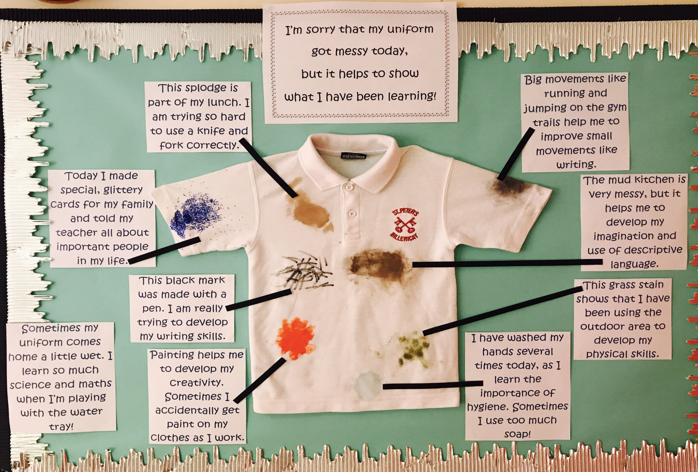
Learning can be messy!

Slide 14
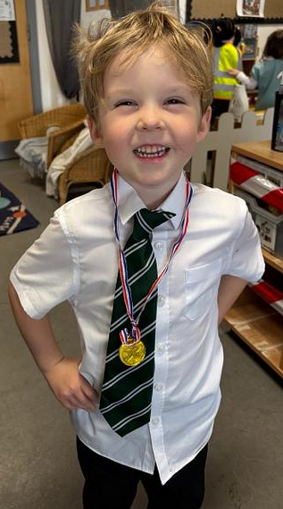

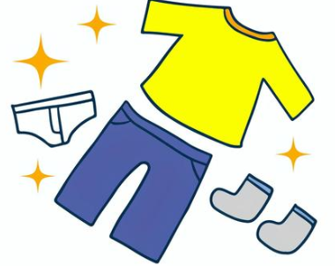
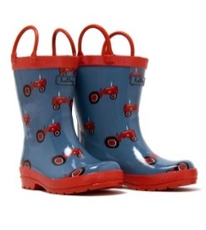
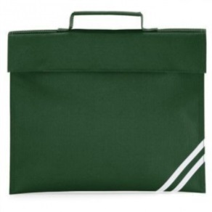
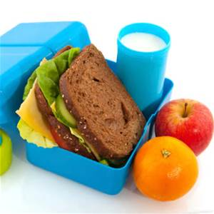

Things to bring in the first week
Book bag *each child with be issued with a book bag at their transition afternoon, or if unable to make it, in September
Packed lunch (if not having school lunches)
PE kit (plain white t-shirt, black or green shorts, jogging bottoms, plimsolls) These will remain in school and sent home in half term or sooner if needed
Spare clothes
Please ensure everything that comes into school is named!!
Wellies
A big smile! ☺

Slide 15
Parents as partners
How will the school share information with me?
Need to pass on a quick and important message: we may speak to you on the gate before or after school.
Bumped head or injury: will receive a note in book bag for any minor head injuries, if we’re worried we’ll always let you know
Discuss progress: Autumn and Spring face-to-face meeting where we will discuss the interim report and then you will receive End of Year report in Summer term.
Share the learning environment: we will invite you to come and play with your child in their new learning environment

Slide 16
Attendance
Attendance is very important at Maltese Road Primary School.
We aim for children to attend school at least 95%
It is important that you ensure your child attends regularly.
Your child will be learning the moment they step through our school gates.
Having good attendance in Reception gives them a good start to their education journey
As a school and local authority we monitor and track attendance.

Slide 17
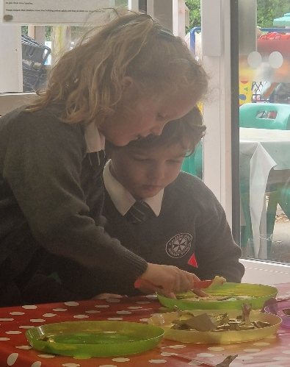
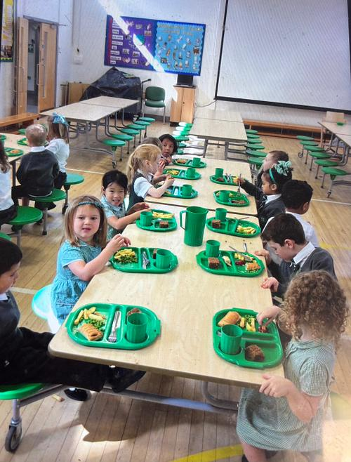
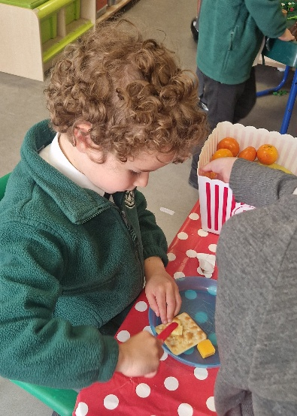
Top Tips for the Summer
How can I get my child “school ready”?
► Encourage them to be more independent - putting on their own shoes, putting on socks, trousers, learning to put on and pull off their jumpers, putting on and off coats.
► Teaching children the language that goes with these actions - pull, push, unzip, down, up. Encourage them to ask you rather than pull at things or tap. The greater their language communication the more they can express the support that they require.
► How to hold a knife and fork and spoon for dessert. Learning to cut simple soft foods like fish fingers and vegetables. Using a knife to push food onto a fork - play games with small items like peas, sweetcorn to practice.
► Going to the toilet, pulling clothes out of the way, wiping themselves, flushing toilets and washing hands.
► Putting wellies on and off and changing back into shoes.
► Lots of positive praise at small step achievements.
► Talk of school as a positive always - fun, friends, learning new things but with lots of help, remind them that you went to school.
► Teaching them to tidy up after themselves.
Notes:
Great books in local libraries about starting school. You can ask for a ‘starting school bag’
Practise lots of skills for independence, they will have to share adults more than before so will need to get used to doing more on their own

Slide 18
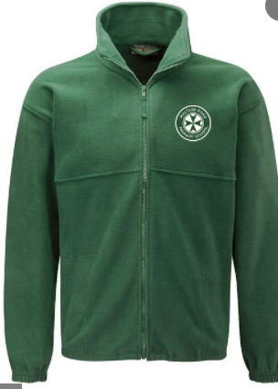
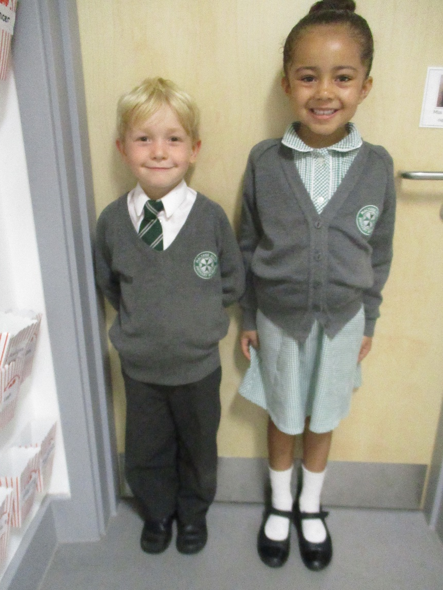
School uniform

Slide 19
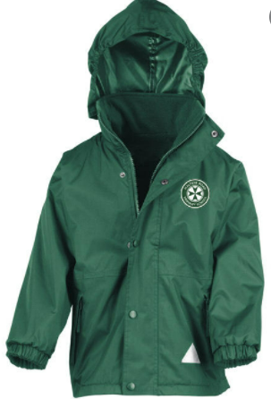
All weather - In school provisions
(To stay at school)
Wellies
Waterproof coat
– doesn’t have to be a school coat
Please ensure everything that comes into school is named!!

Slide 20

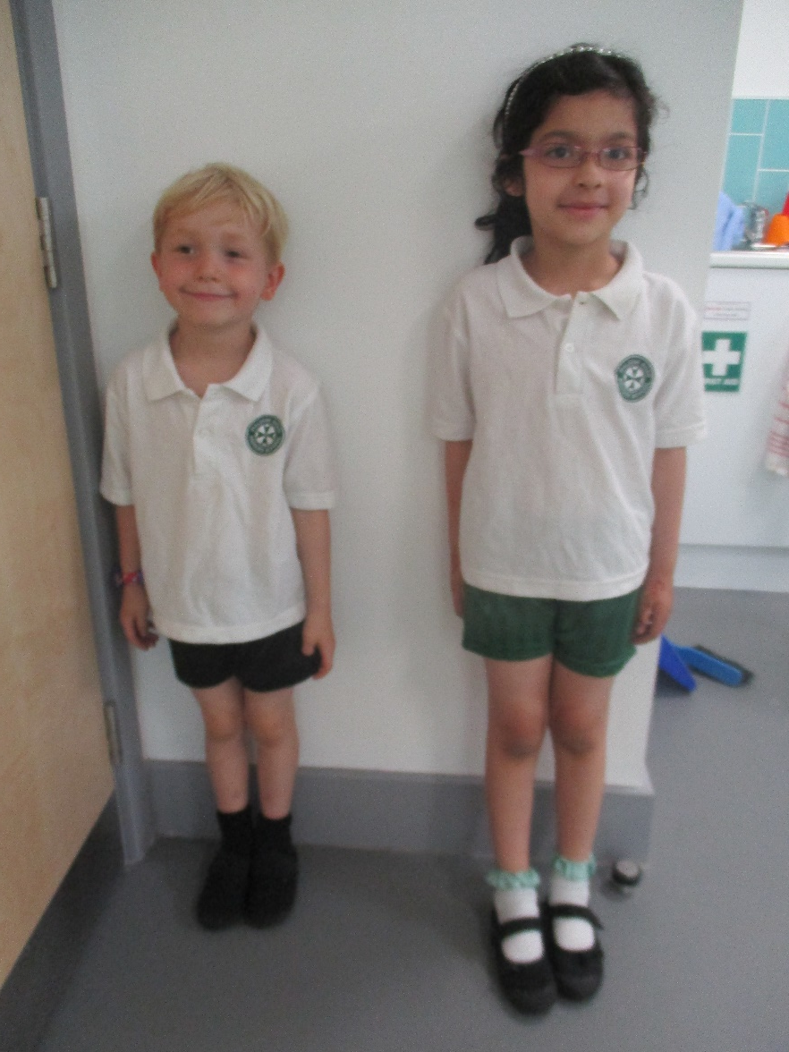
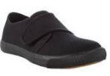
PE Kit
(To stay at school)
Please ensure everything that comes into school is named!!

Slide 21
Transition to School
Before September
Wednesday 24th June – 1.15pm – 2.30pm
Transition Session for Group A children only – (Surnames A-O)
Thursday 2nd July – 1.15pm – 2.30pm
Transition Session for Group B children only – (Surnames R-Z)
Tuesday 7th July – 9.30am – 11.00am
Teddy Bears Picnic – Please send your child with their favourite
cuddly toy, a small
snack and a drink (accompanied by parent)

Slide 22
Transition to School
In September
Wednesday 2nd September – 9.15am – 11.00am
First day of term Group A: Children Only.
Morning only at school
Wednesday 2nd September – 1.15pm – 2.45pm
First day of term Group B: Children Only.
Afternoon only at school
Thursday 3rd September – 9.15am – 11.30am
All children – Morning only
Friday 4th September – 9.00am – 12.15pm
All children – Morning and Packed lunch at school
Monday 7th September – 8.30 – 3.00pm
All children – First full day at school

Slide 23
Useful School Readiness Resources
(Leaflets included in pack)
Starting Reception – NHS advice: https://www.nhs.uk/start-for-life/
BBC Tiny Happy People: https://www.bbc.co.uk/tiny-happy-people
Hungry Little Minds: https://hungrylittleminds.campaign.gov.uk/

Slide 24
Any questions, please don’t hesitate to ask, email or phone. admin@maltese.essex.sch.uk
01245 357 860
Notes:
Really does start with you- home school partnership is vital to a happy successful time at school.
Teddy bears picnic – if chn could bring their favourite bear and a snack.

