Slide 1
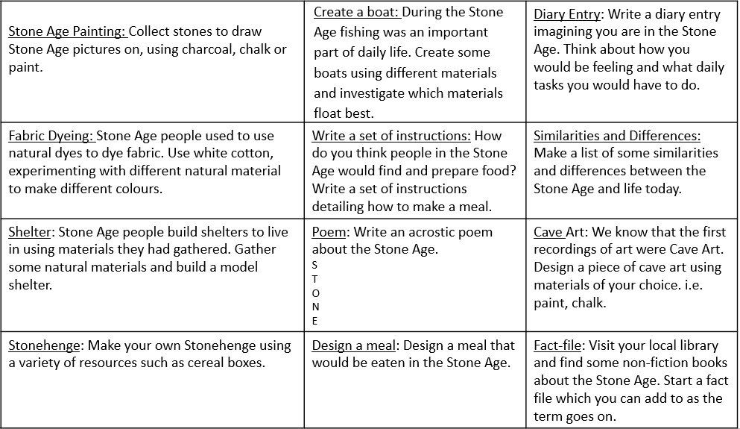
Year 3
Autumn Term
Stone Age
If you would like an extra homework challenge, have a look below.

